Slide 1

Innovation Project

Slide 2
Research
Ocean zones: https://www.youtube.com/watch?v=sE8JYv_cKng
Surface Layer – has visible light
Twilight zone – Dim light, enough for animals to see but not for plants to grow
Midnight zone (bathypelagic) – Only light is from bioluminescence
Studying submarine volcanoes: https://www.youtube.com/watch?v=vfDNJMSduJo
Mariana Trench: https://www.youtube.com/watch?v=VoEVezcE0k0
The Mariana Trench is 36,000ft deep
The deepest fish is the snail fish at 26,000ft; sea cucumbers live at the bottom
PLASTIC was found in the trench
SCUBA divers play a big role in ocean exploration
Much of the ocean hasn't been explored - https://www.abyss.com.au/en/blog/viewpost/648/how-much-of-the-ocean-is-explored-and-why-were-just-scratching-the-surface

Slide 3
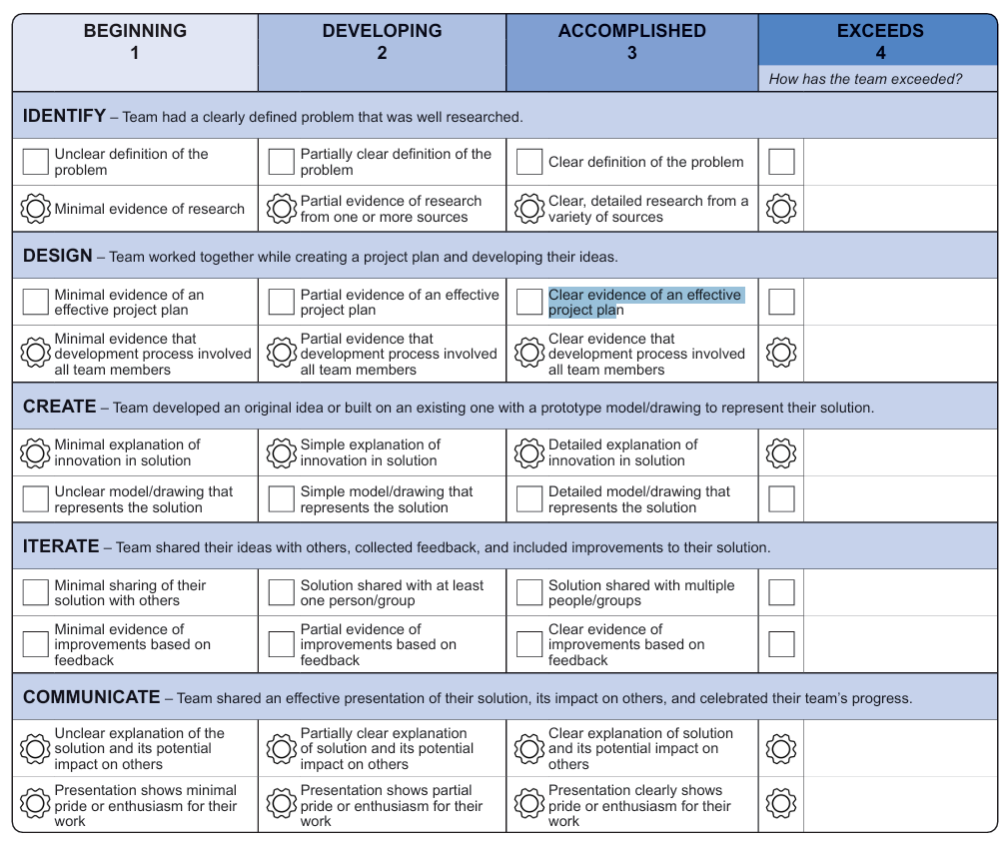

Project plan
Wow!
Amazing!
Incredible!
Spectacular!
Great!
Impressive!
Really good!
Running out of synonyms here!
Stupendous!
Breathtaking!

Slide 4
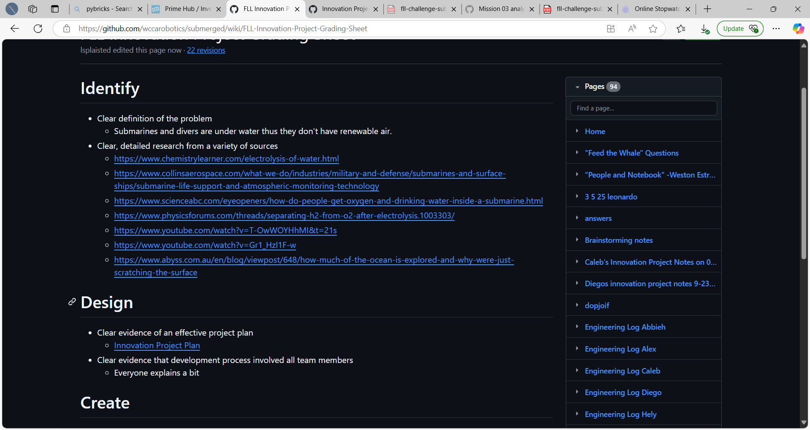
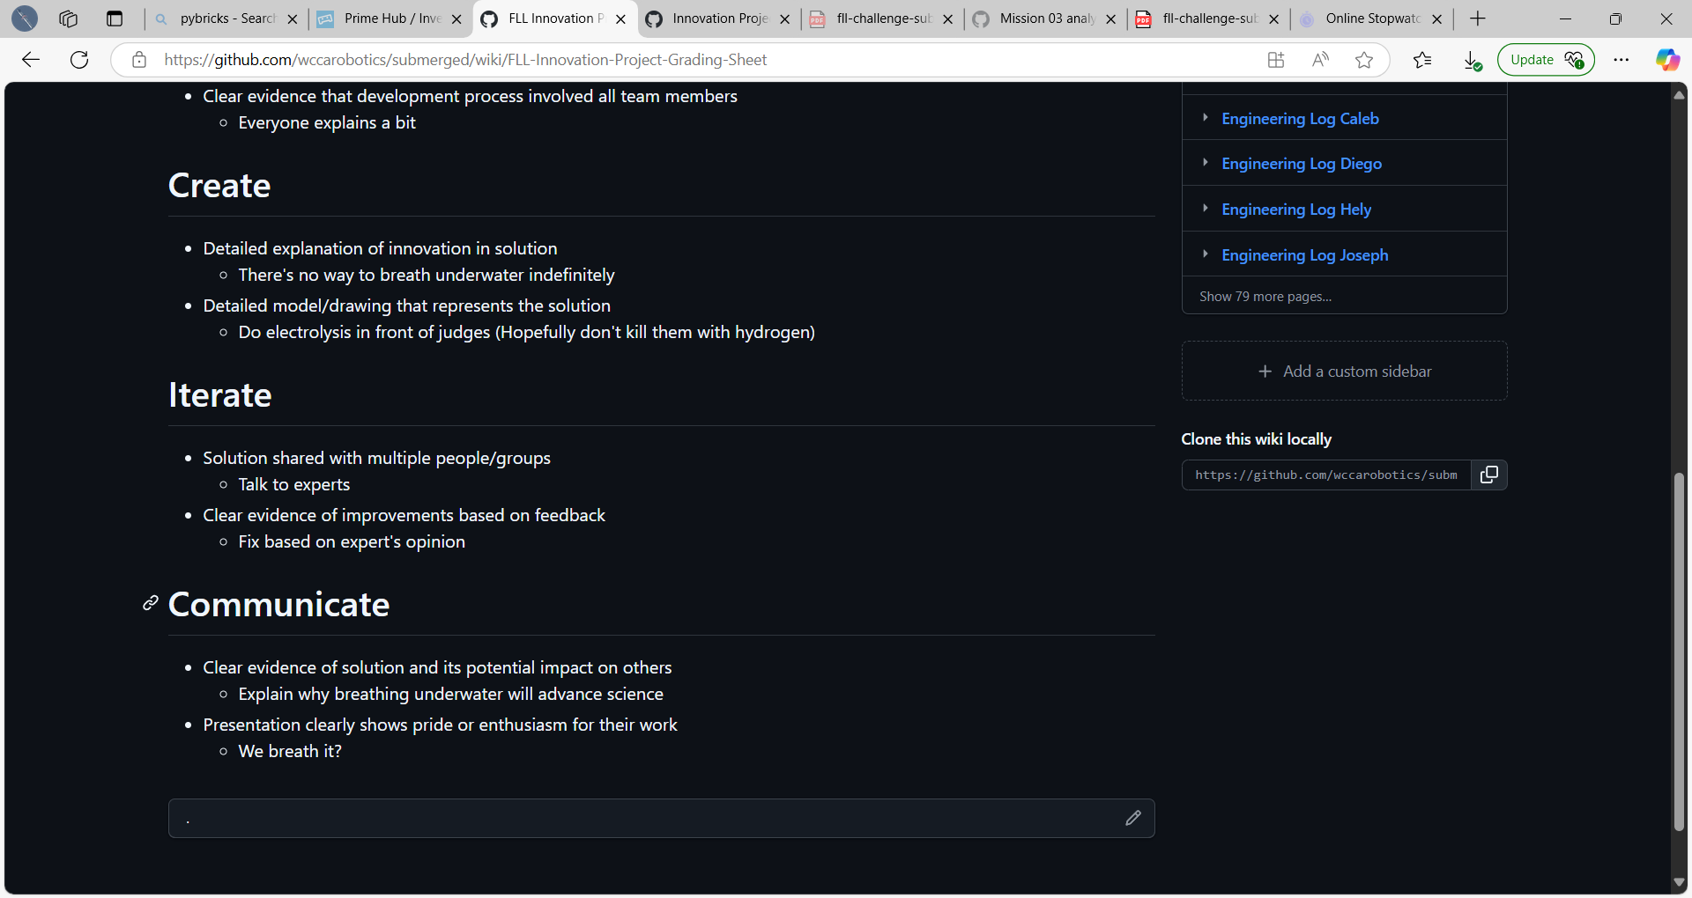
Project plan

Slide 5
Identify Problem - Brainstorming
No Power Underwater
long wire for power and oxygen
water turbine to capture energy from currents
electrical generator from submarine volcanoes
No Air Underwater
gills to extract oxygen from water
Dangerous to Explore
Computer exploration
No Food
Garden in submarine
Cramped in submersibles
No proposed solution
Trash
Cleaning robots
Oil spills
Oil catching robots
Pressure
Strong alloy
“Stepped hull”
Dust in water
Dust catching nets
Animals are Dying
No Proposed Solution
Idk if this is a real note or a joke note. Pls checkout "People and Notebook" ‐Weston Estrada, 2024 (aka the Joke Notes)
Animals will die until God returns.

Slide 6
Electrolysis
Electrolysis is using electricity to separate Hydrogen and Oxygen in water
https://www.chemistrylearner.com/electrolysis-of-water.html
Submarines use electrolysis to generate Oxygen for breathing
https://www.collinsaerospace.com/what-we-do/industries/military-and-defense/submarines-and-surface-ships/submarine-life-support-and-atmospheric-monitoring-technology

Slide 7
Problem statement
SCUBA divers play a key role in ocean exploration, but they are limited by the amount of air in their tanks

Slide 8
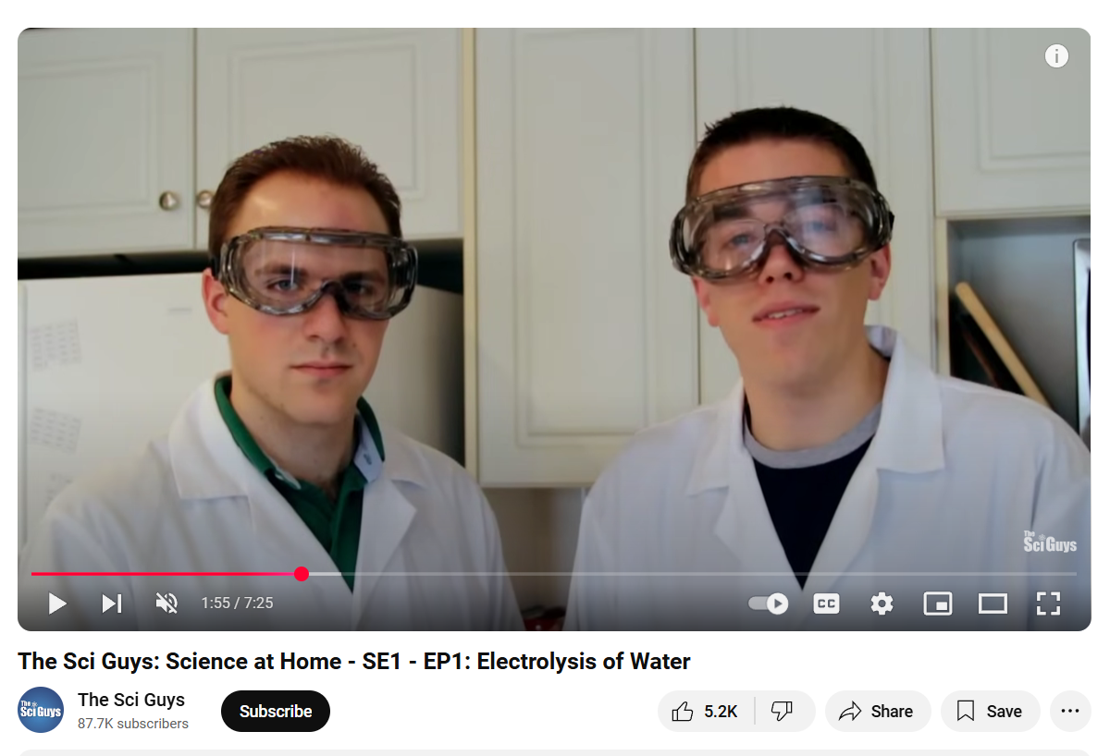
Further research
Salt can be used to help electrolysis, but it generates unwanted side products
https://www.youtube.com/watch?v=T-OwWOYHhMI&t=21s

Slide 9
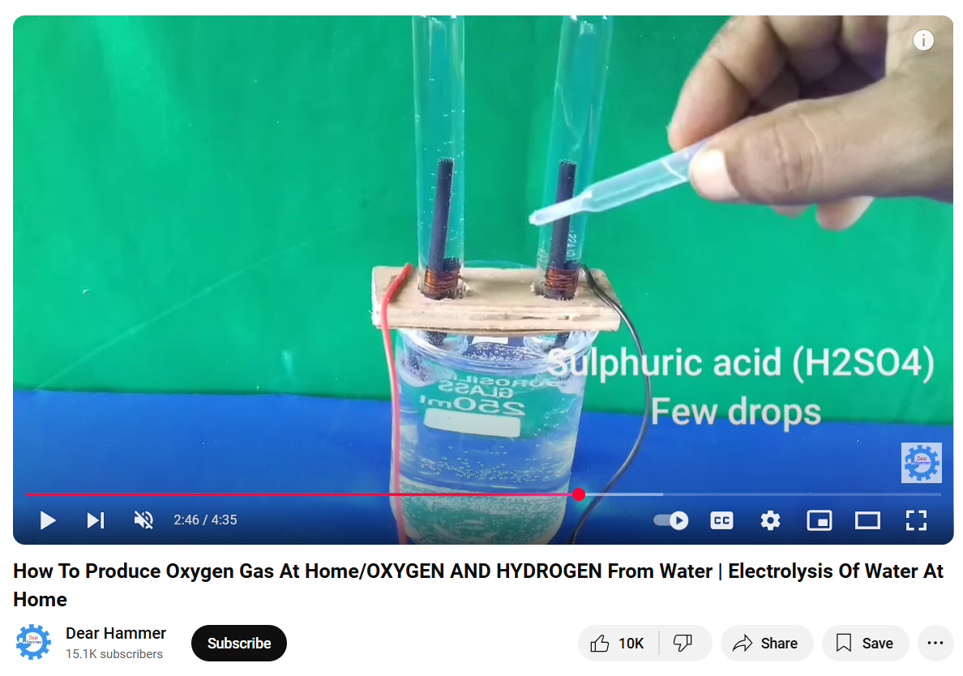
Further research
Sulphuric acid can be used instead of salt

Slide 10
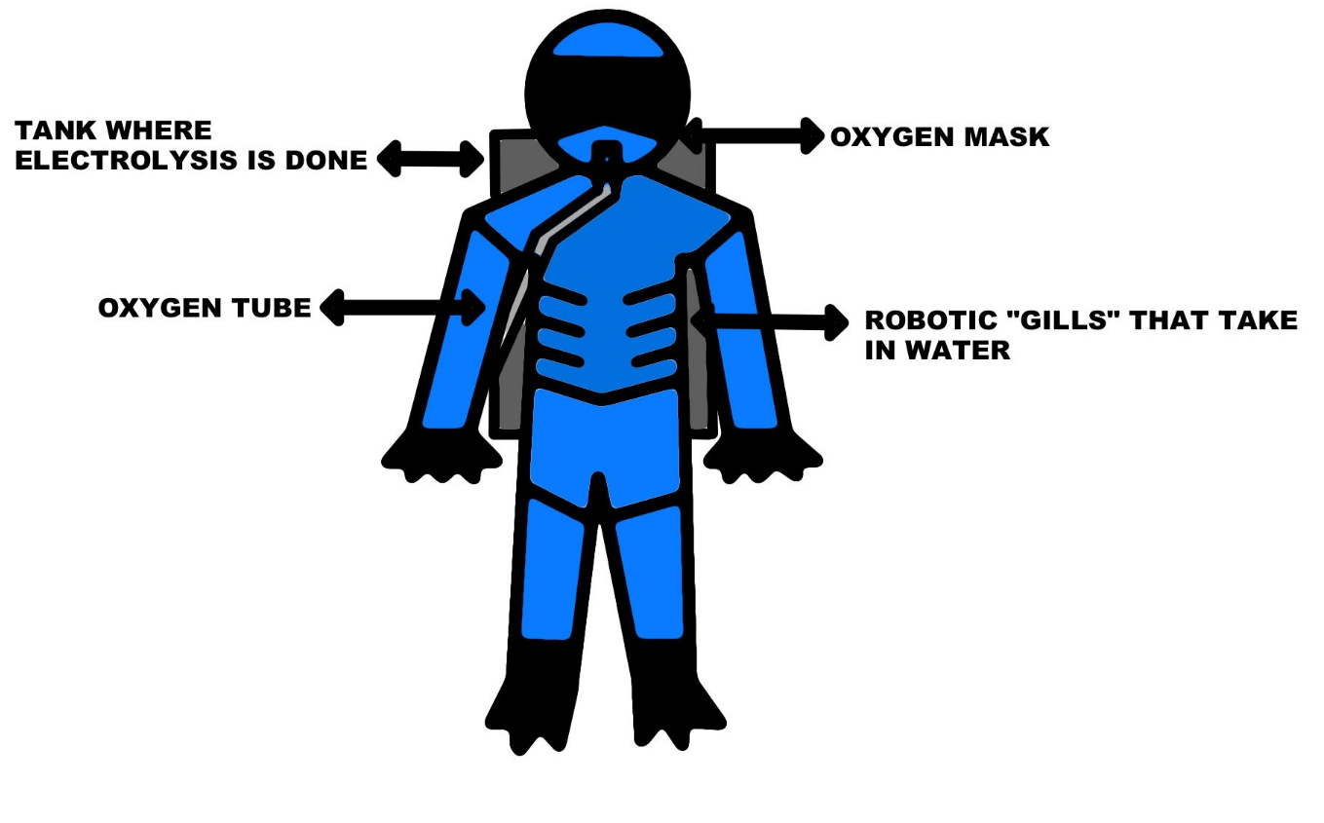
Initial Proposal: Electrolysis Suit

Slide 11
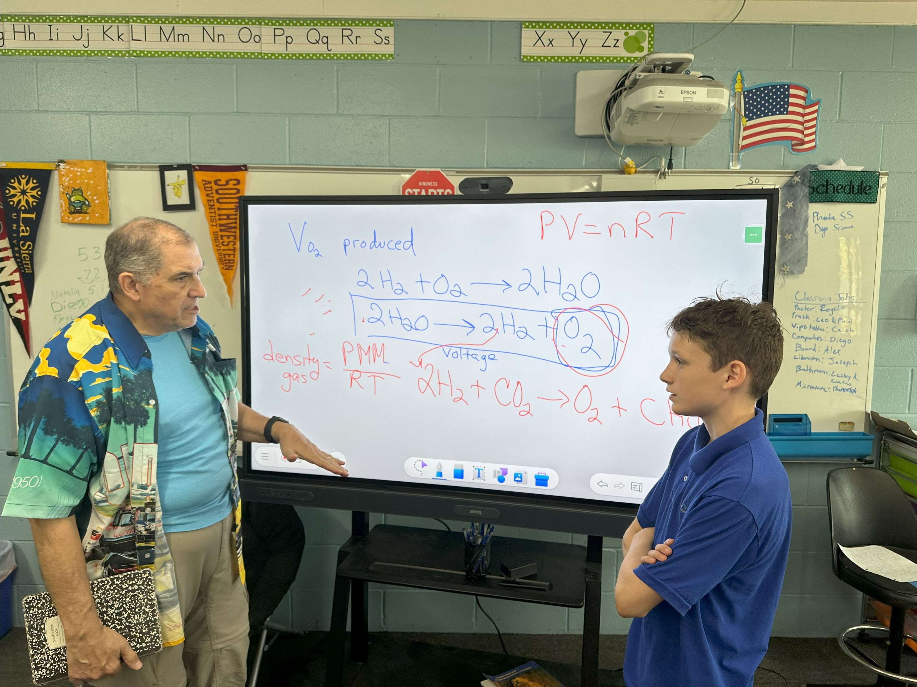
Meeting with Chemistry Professor

Slide 12
What we learned from Doctor Gambino
You can’t breathe pure oxygen, you need a filler gas
Pressure increases the further you go under water, by 1 atmosphere per 33 feet
Nitrogen is typically used as a filler gas, and Helium is used for deeper dives (300 feet). Neon might also work. Helium makes you talk funny
The mix of Nitrogen to oxygen changes depending on the depth you plan to dive, to avoid Nitrogen Narcosis (which is like being drunk)

Slide 13
What we learned from Doctor Gambino
Sulphuric acid is dangerous, not recommended
Backpack sized nuclear reactors are also not recommended
Decompression stops are needed for deep diving
NASA uses electrolysis on the space station to recycle oxygen

Slide 14
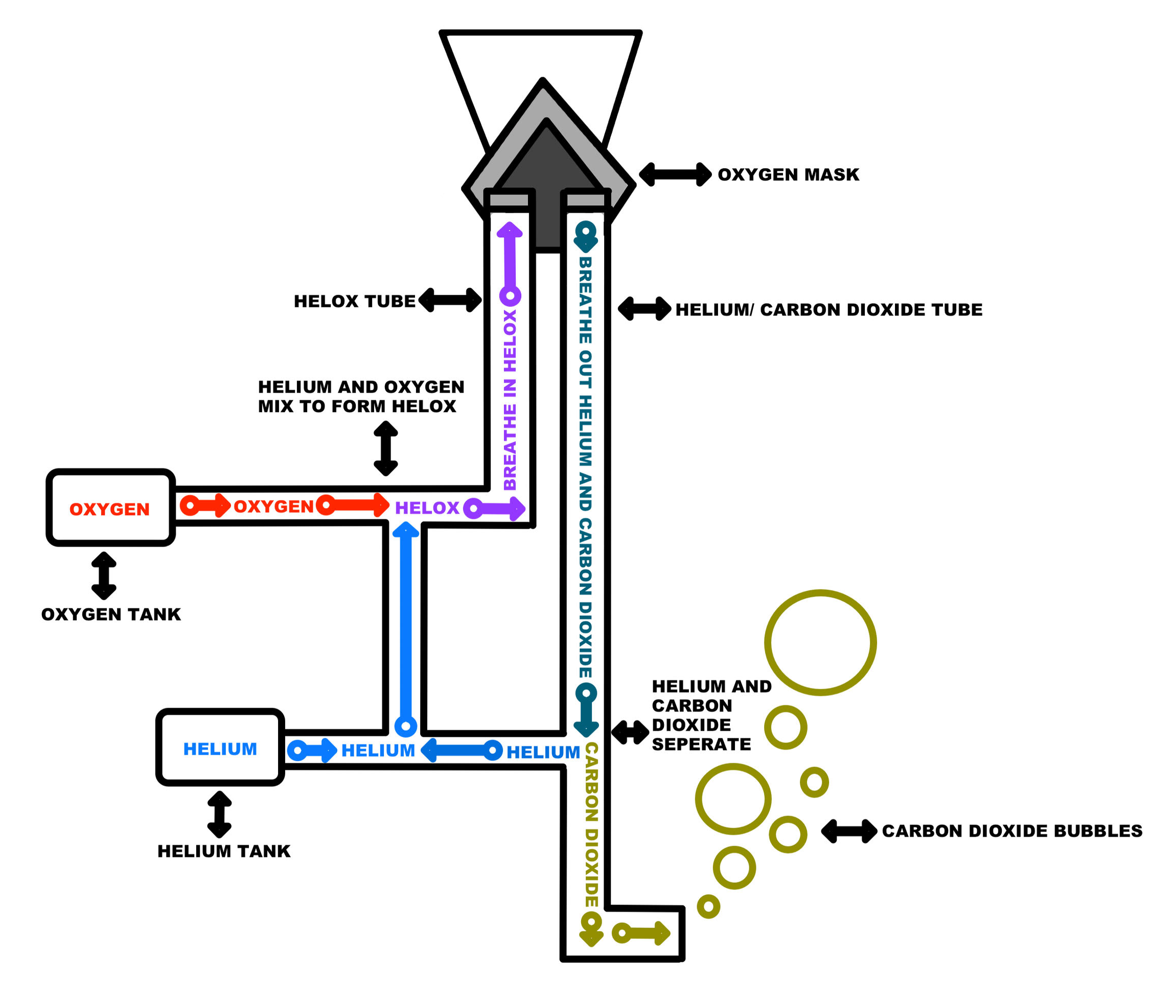
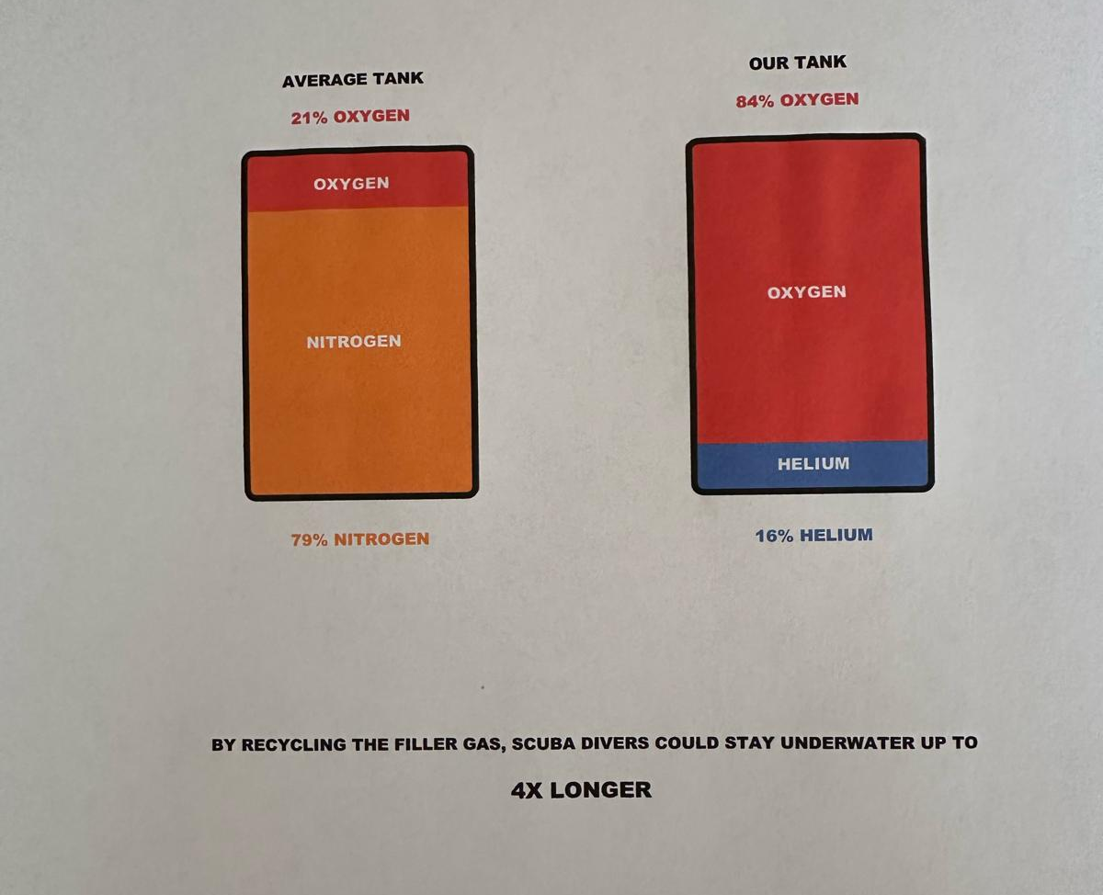
Updated Proposal – Phase 1

Slide 15
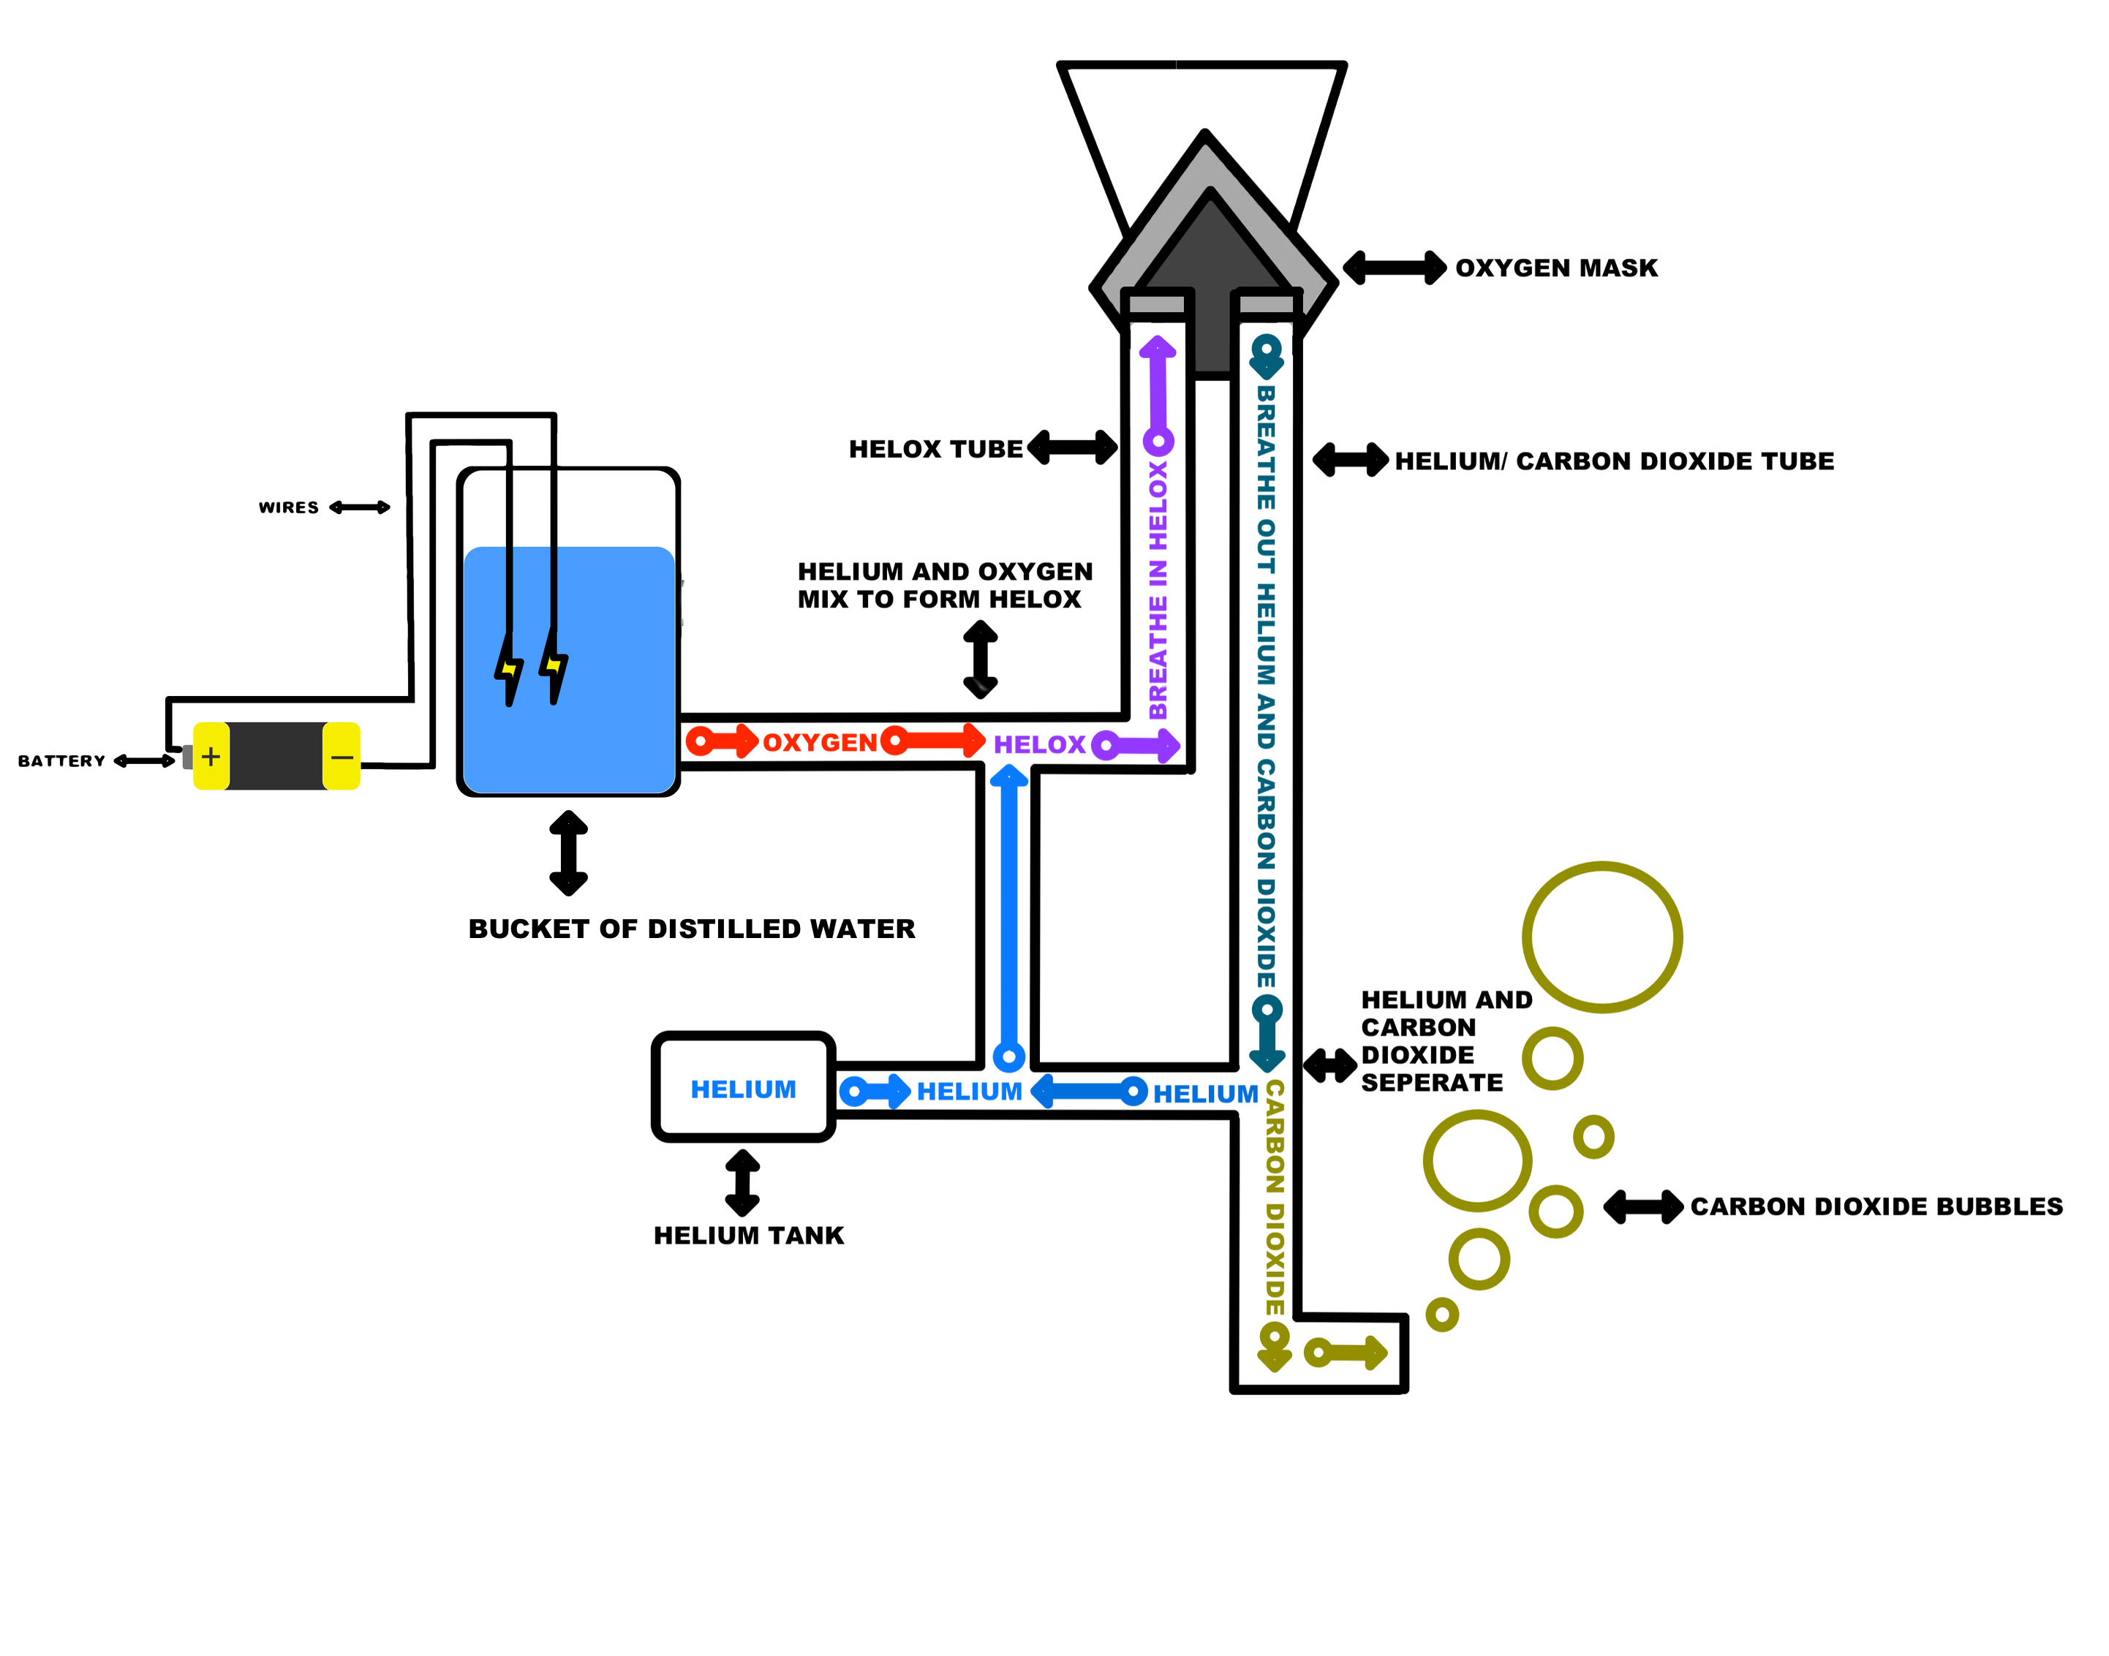
Updated Proposal – Phase 2

Slide 16
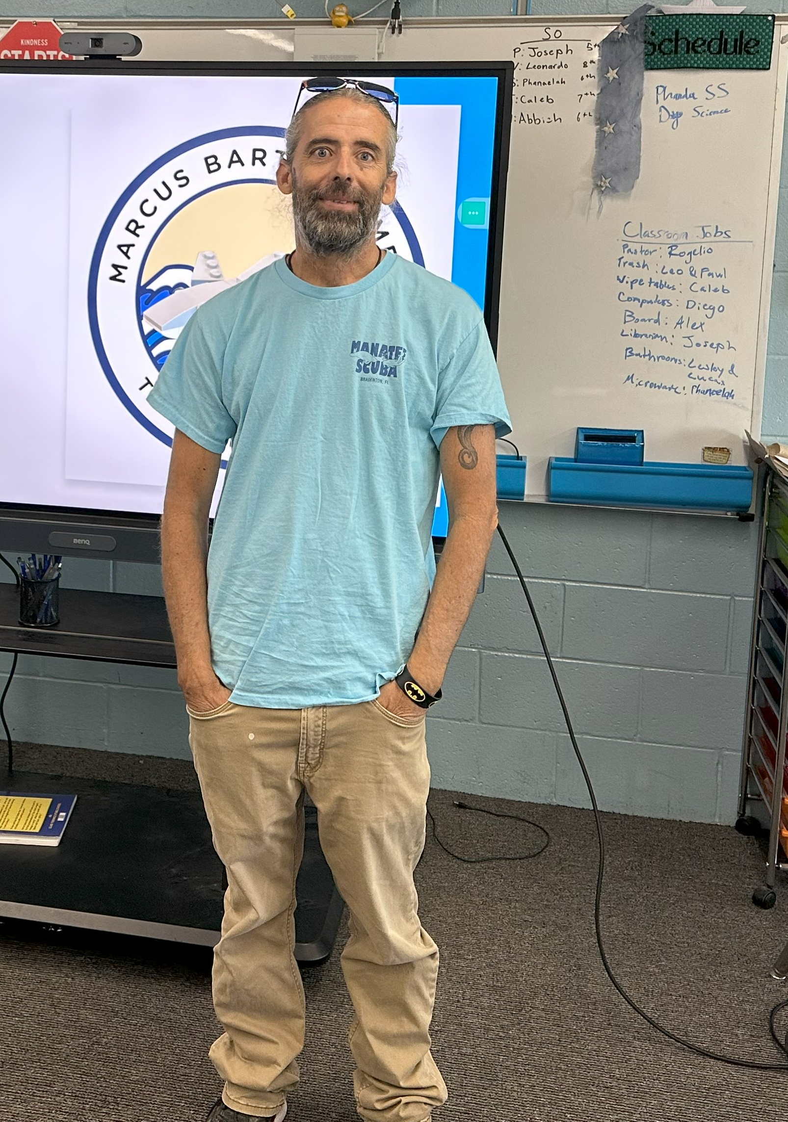
Met with Diving Instructor (Rick Carlton)
Scuba diving is fun!
See amazing creatures
Underwater is carefree and relaxing – no stress, no worries
He liked our proposal
Would help with cave diving
Can spend more time
Can’t use oxygen hoses in caves
Need to spend lots of time decompressing for deep dives
Could be used for saturation diving
No bubbles would be an advantage
Scientific diving – bubbles scare fish / change behavior
Underwater photography – bubbles get in the way of picture

Slide 17
Met with Diving Instructor (Rick Carlton)
The deeper you dive, the less time you can spend underwater
Increased pressure means you use up air supply faster (Boyle’s law)
Increased pressure means your body absorbs more Nitrogen
It’s dangerous to surface too quickly
Need decompression stops
Otherwise, Nitrogen bubbles in body will expand, causing the bends

Slide 18
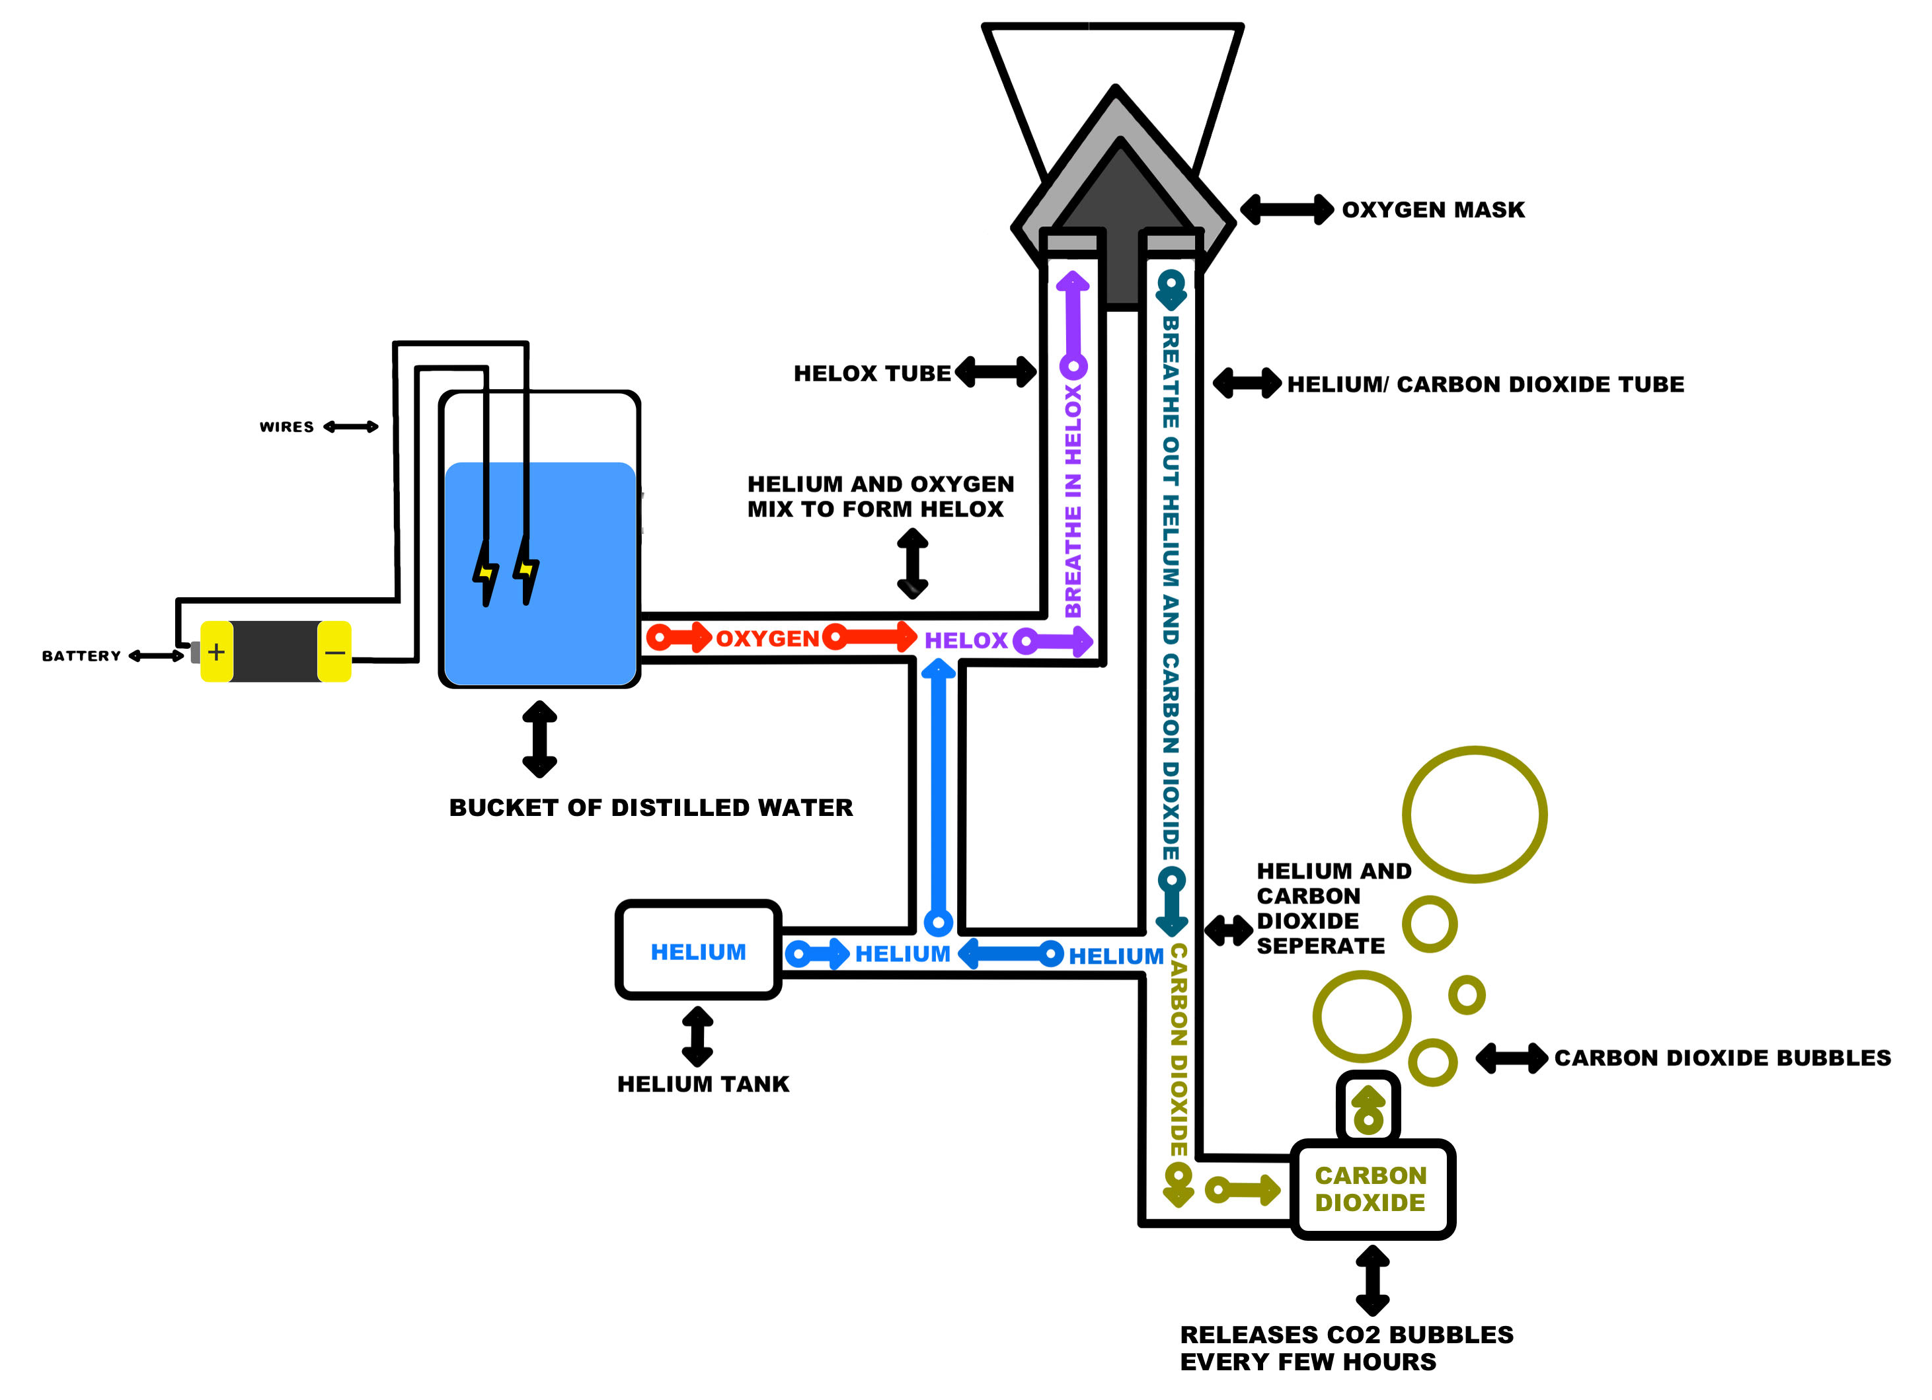
Updated Proposal

Slide 19
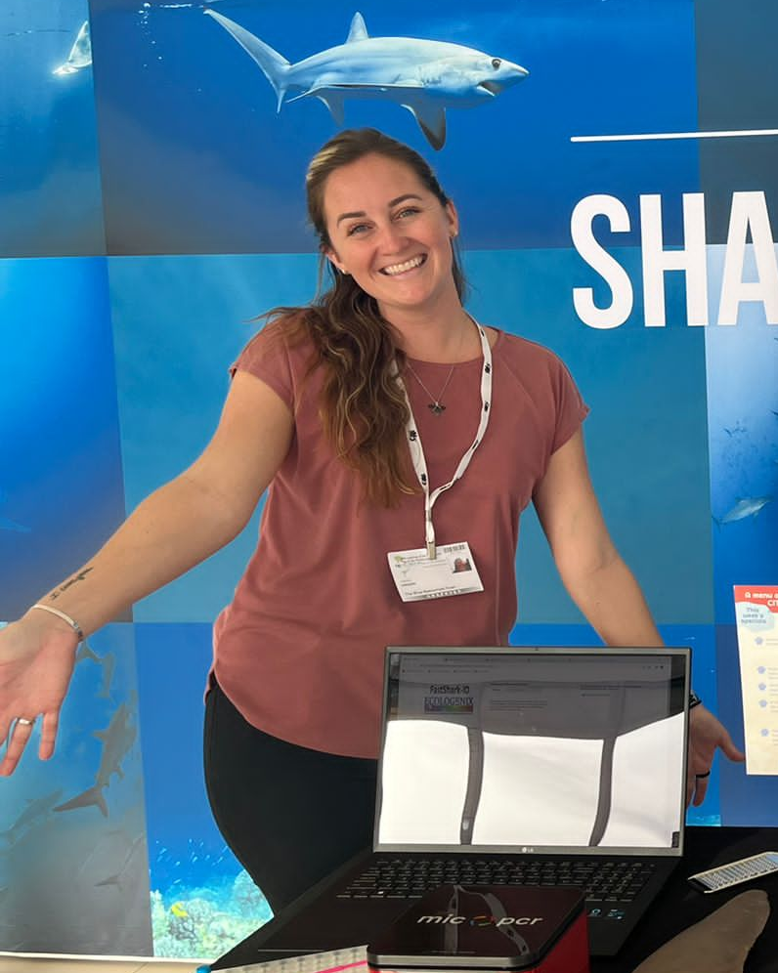
Met with Shark Researcher (Valerie Hagan)
We learned about the types of shark tags
The most known ones are GPS tags, but they cost $5000 and require the shark to surface
Acoustic tags emit ultrasound every 30 seconds and are surgically imbedded.
There are bright orange/yellow tags that are placed on a shark’s fins that if you call the number on it, you get a reward hat.
She trains customs officers to inspect shark meat
There is a toaster sized machine called a PCR that when given a DNA sample it clones it and identifies the shark species.

Slide 20
Met with Shark Researcher (Valerie Hagan)
She really liked our idea.
She said she’d like to use it.
She felt like her tank limited her dives.
She suggested we name our idea.
We named it InfiniDive.
She caught and tagged a shark and named it named Marcus Bartolomew the Third Junior!
Tag is T2355
He is a tiger shark

Slide 21
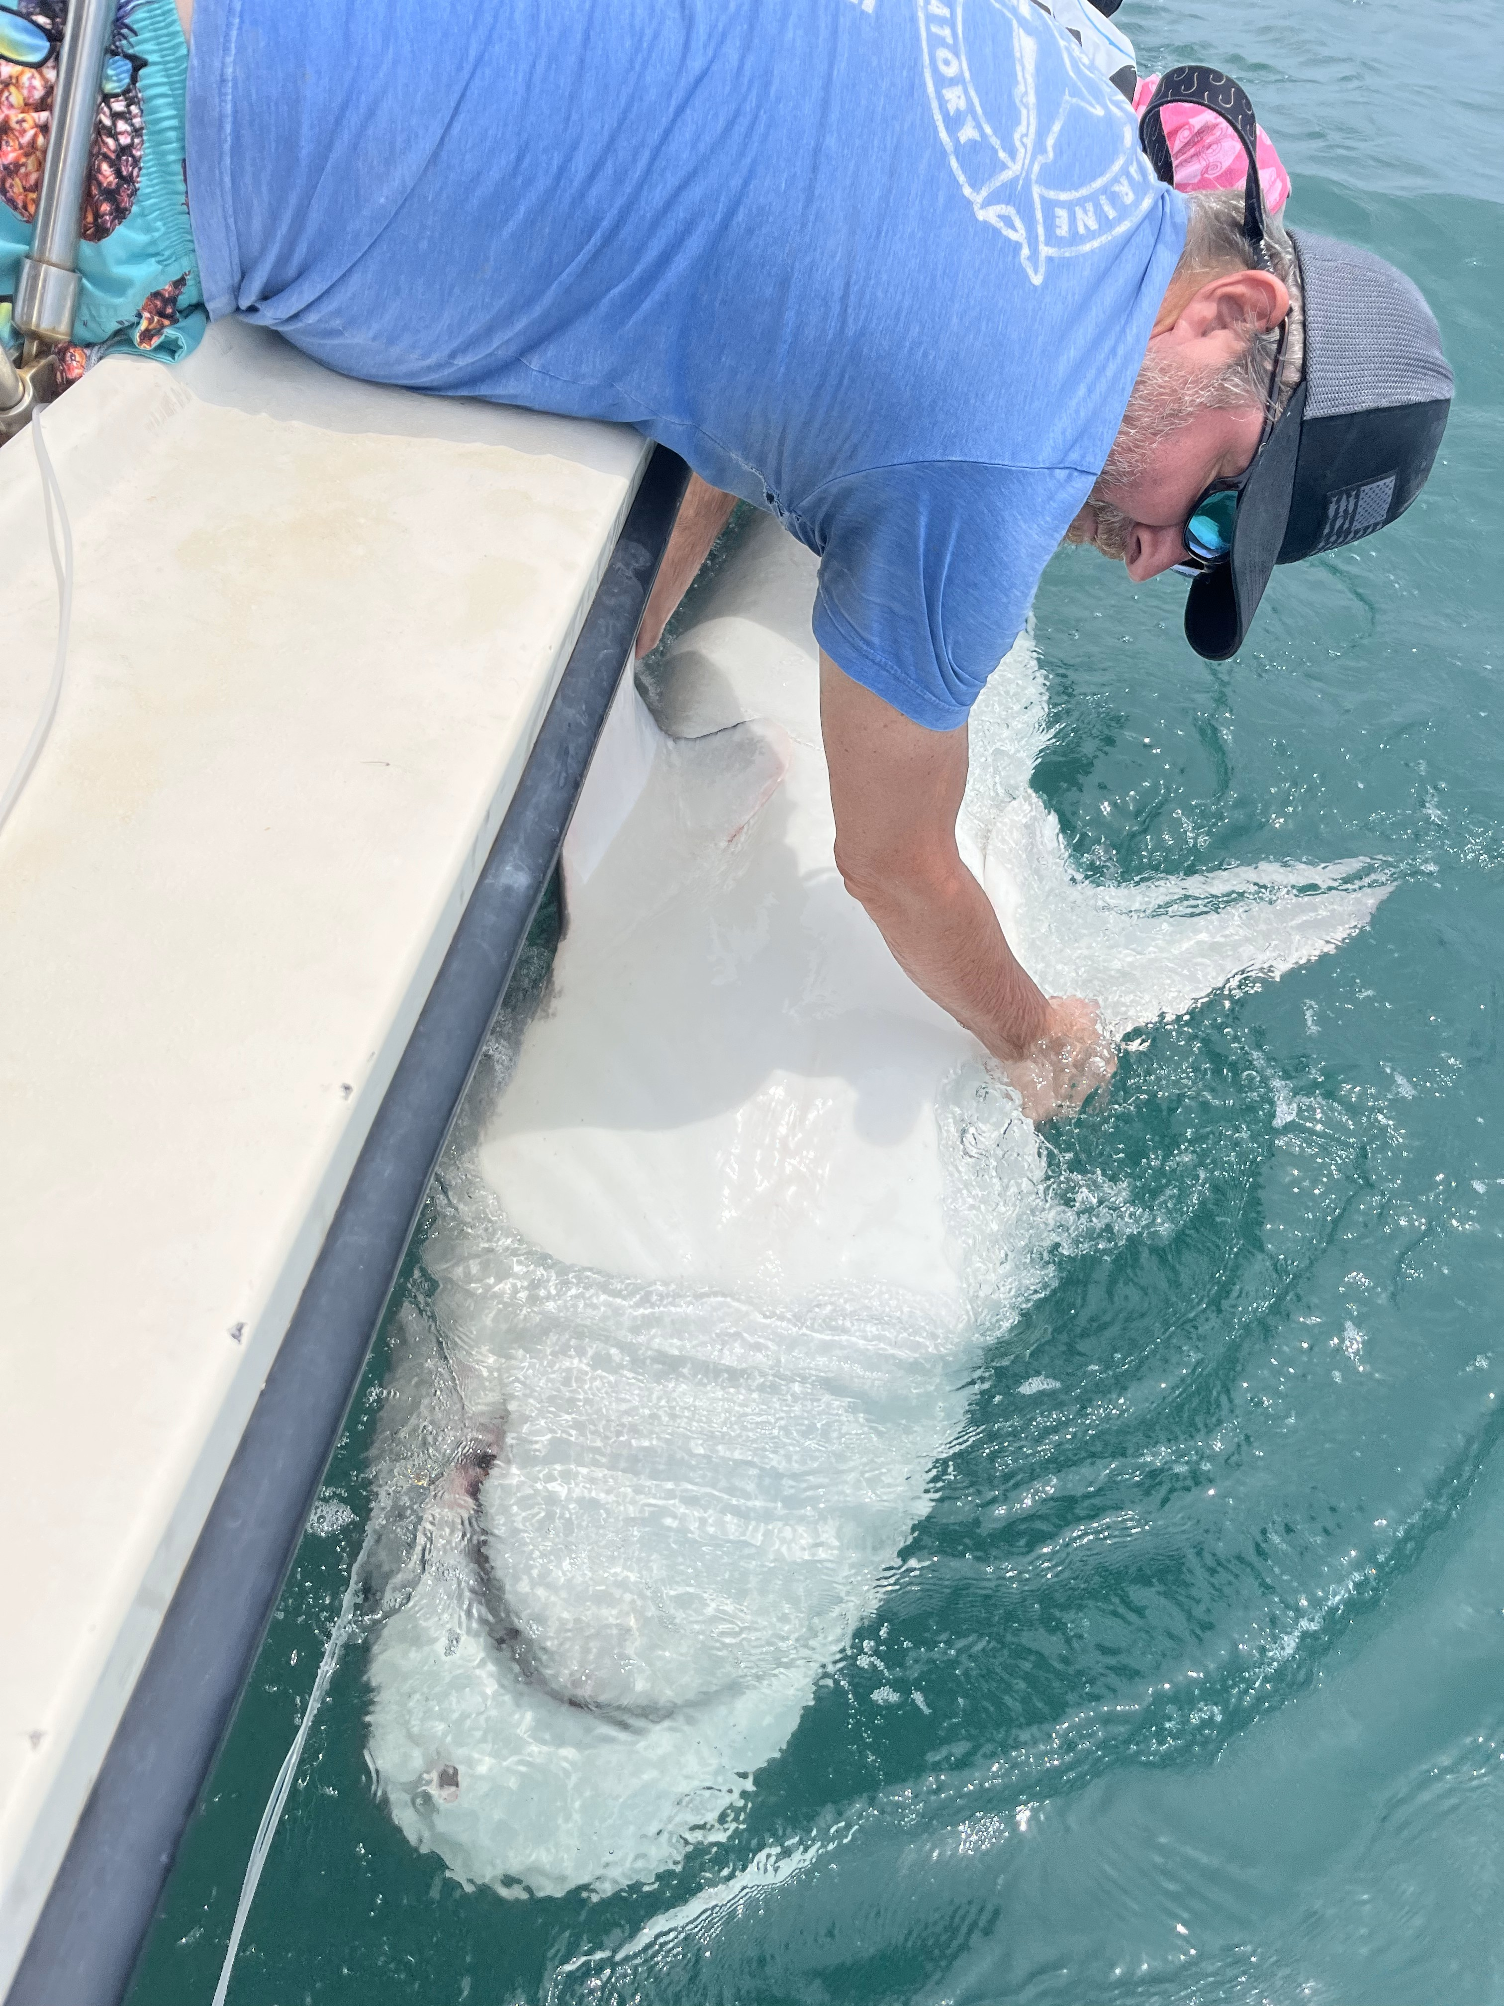
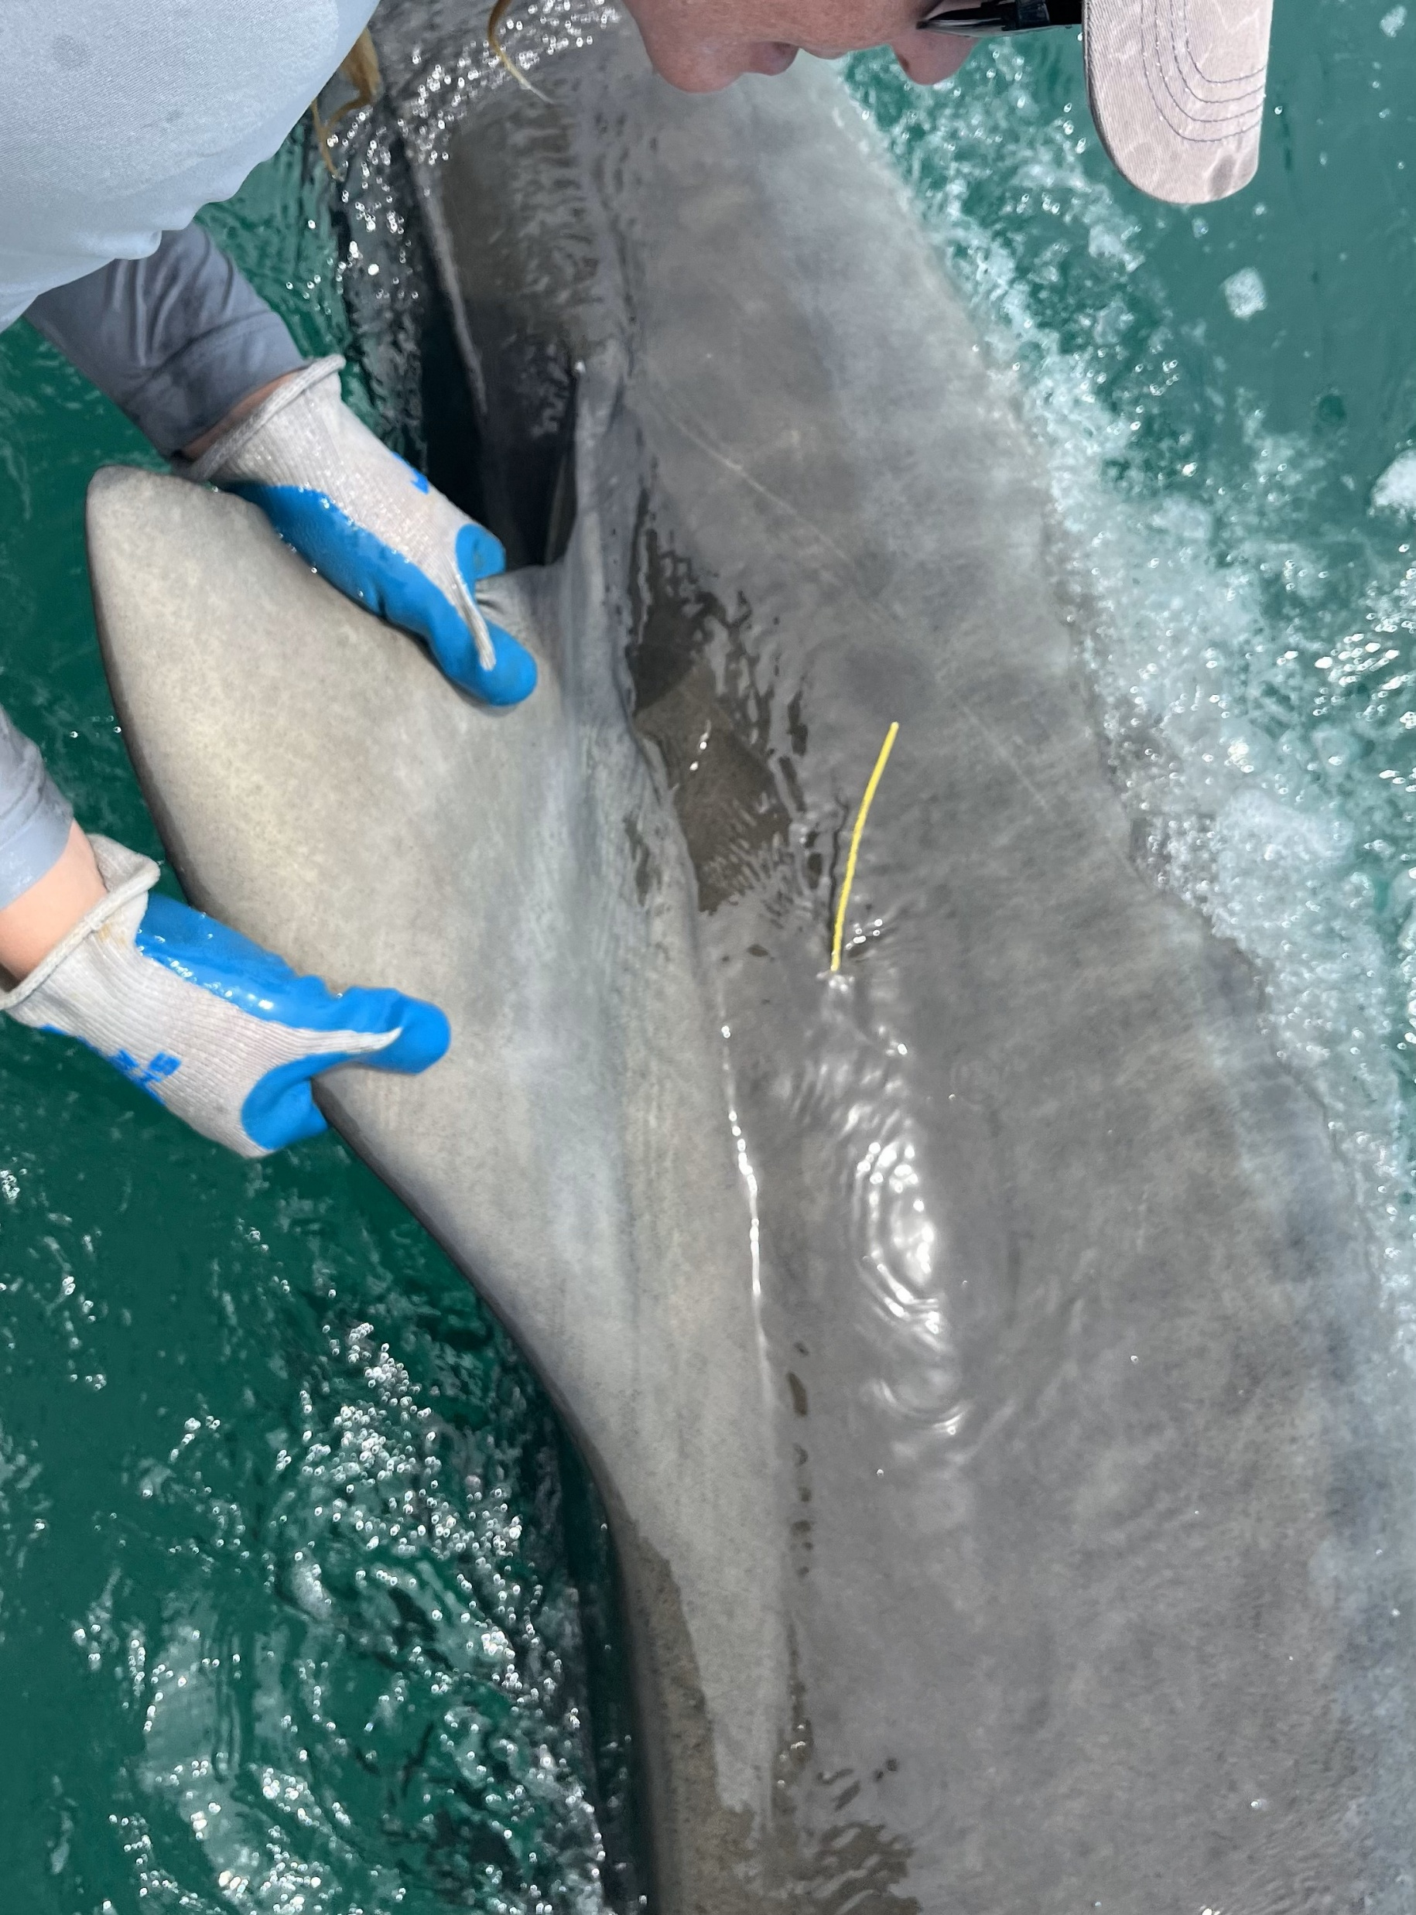
Marcus Bartholomew the Third Junior

Slide 22

Met with recreational diver/pastor (Ken Wetmore)
He liked our idea.
Talked about Rebreathers
Talked about how when diving at a shipwreck he needed two tanks.
Said Electrolysis could be used for underwater colonies
Suggested Naming it Aquabreather

Slide 23
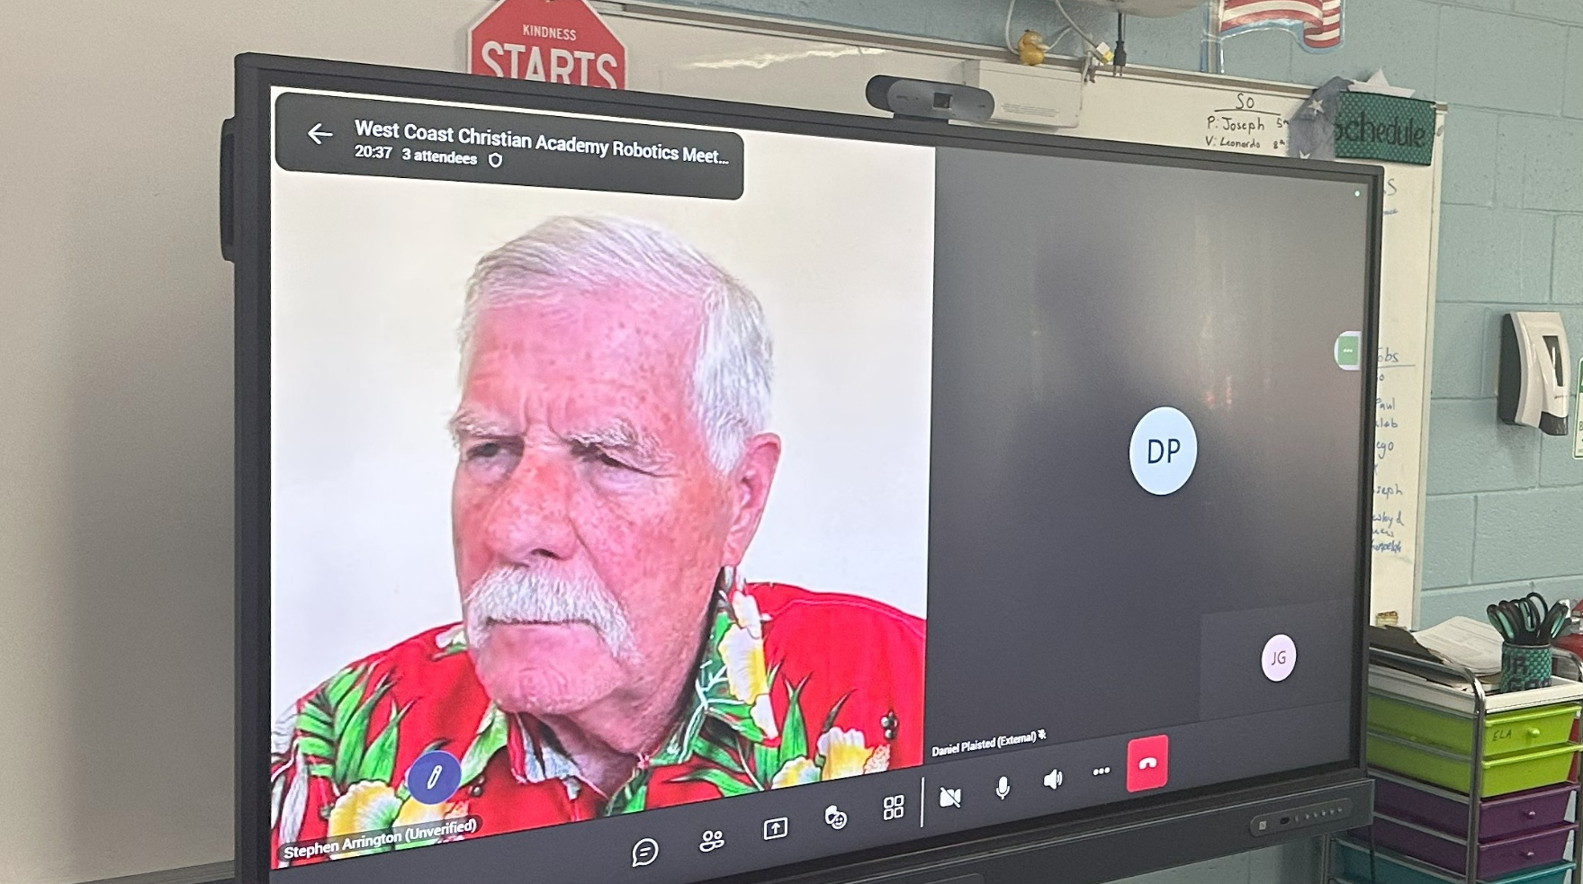
Met with ocean researcher/diver (Stephen Arrington)
He talked about safety
Said that each time someone dives their life could be at risk
Have a backup plan
Communication is hard
Talked about his experiences in life
He was once a diver for Jaques7 Cousteau.
He said to volunteer.
He said we “did our homework”
Talked about KISS
Keep It Simple Stupid!
We are not stupid!

Slide 24
Q & A

Slide 25
Robot Design

Slide 26
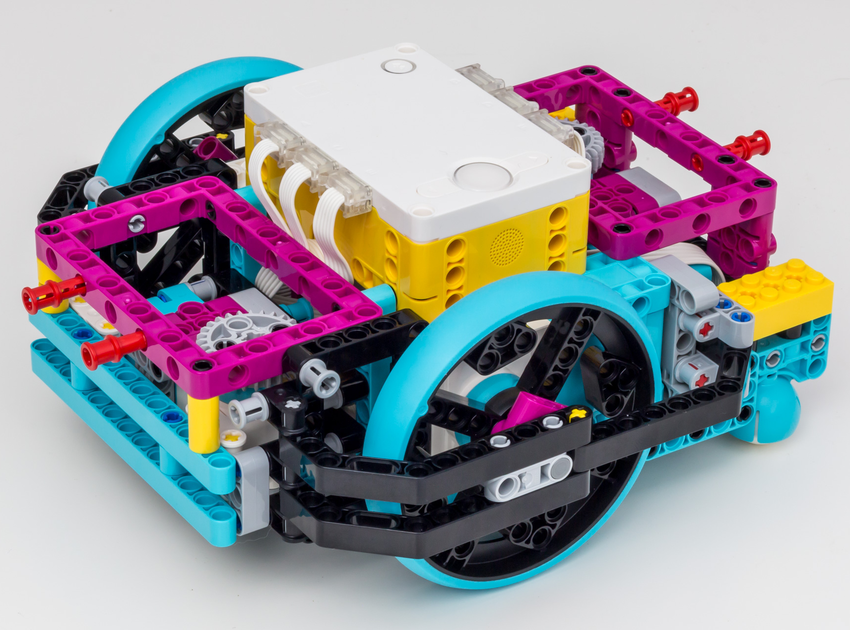
Last Year
First year for team
Placed second in robot game!
Used Advanced Driving Base
Slow attachment swapping
Easy to confuse front and back of robot

Slide 27
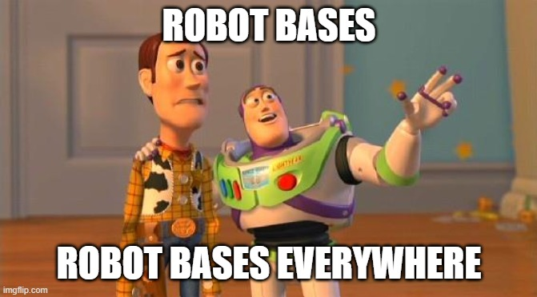
This Year…

Slide 28

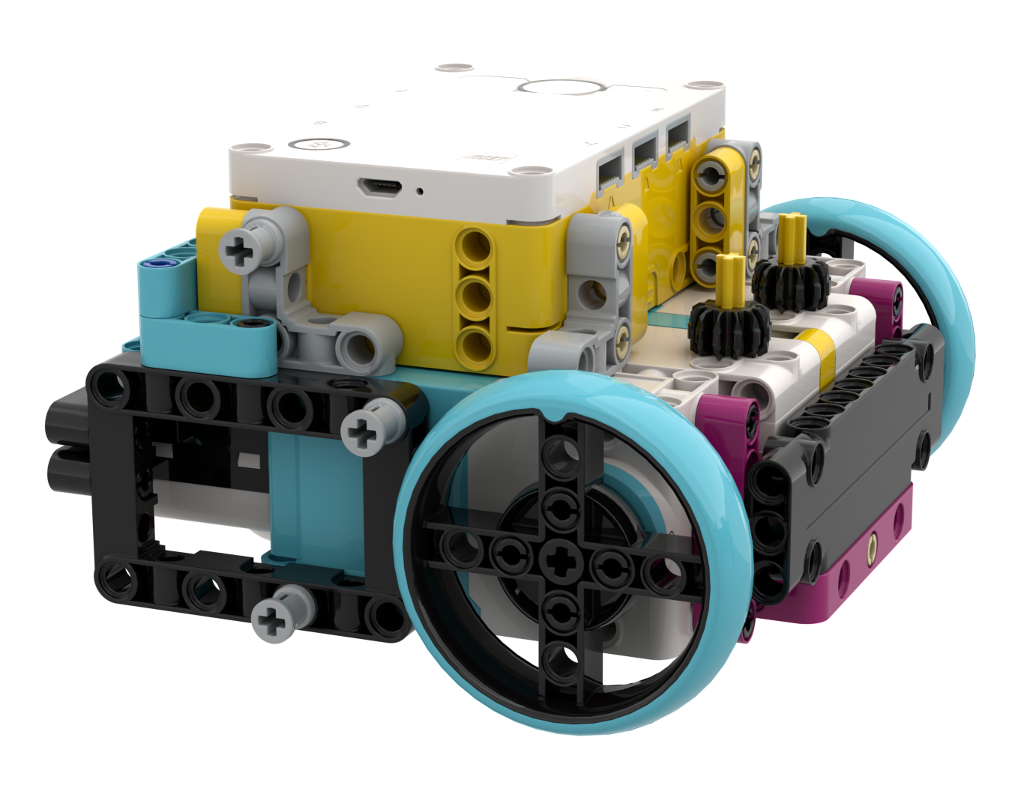
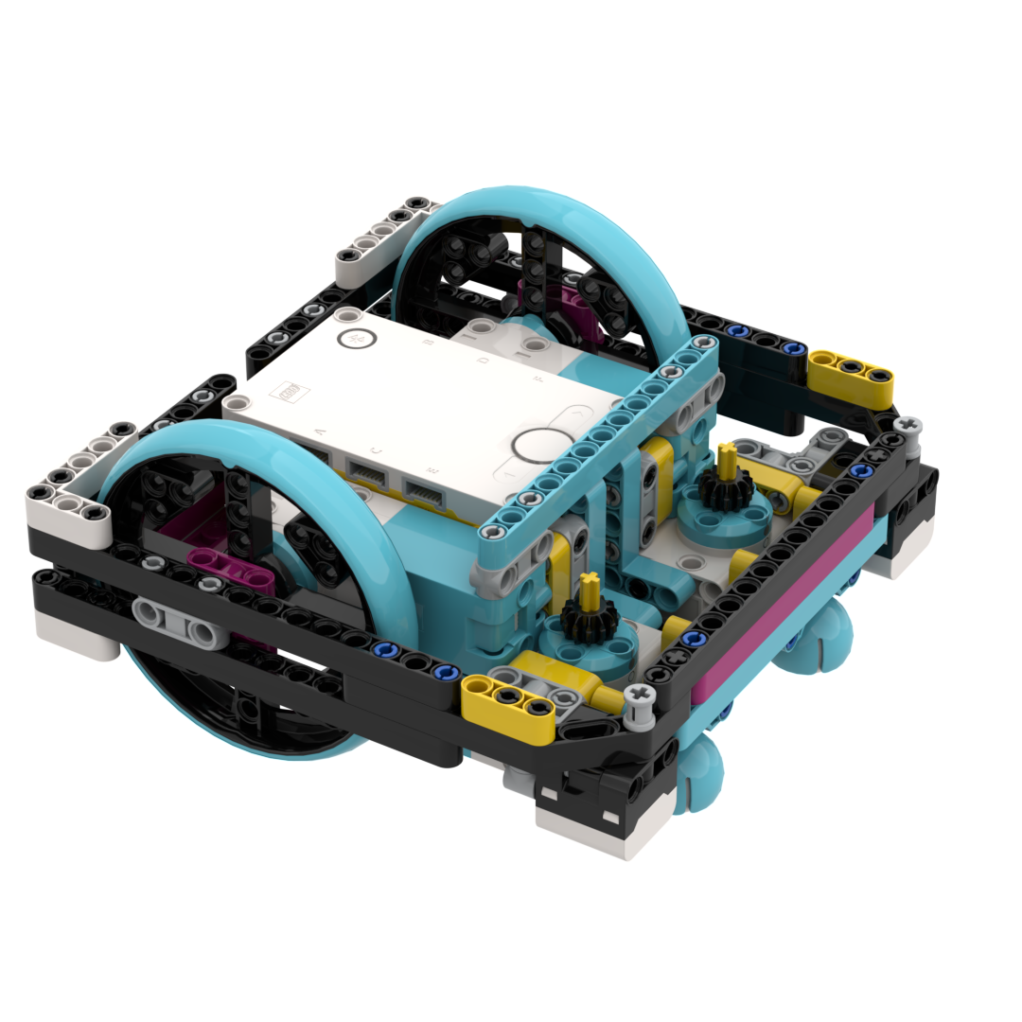
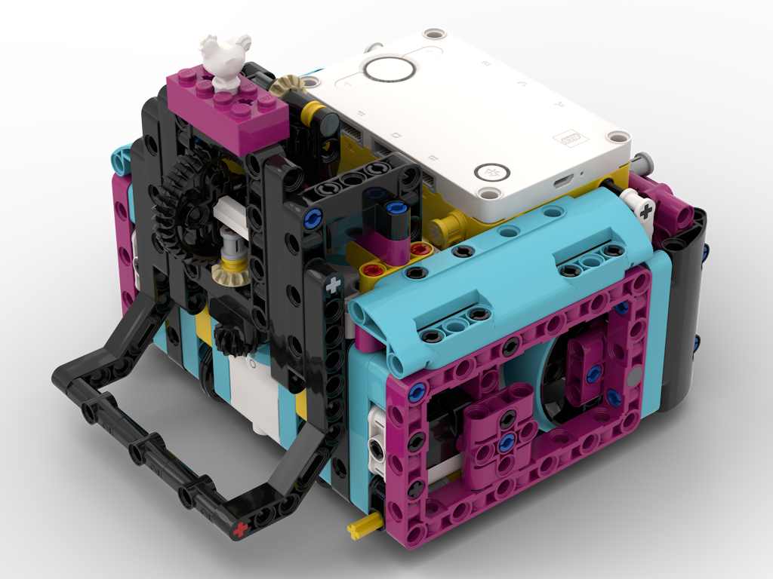

Robot bases from FLLTutorials.com
DroidBot M
DroidBot E
Coop Bot
This icon means the thing being shown is a building or coding resource.

Slide 29
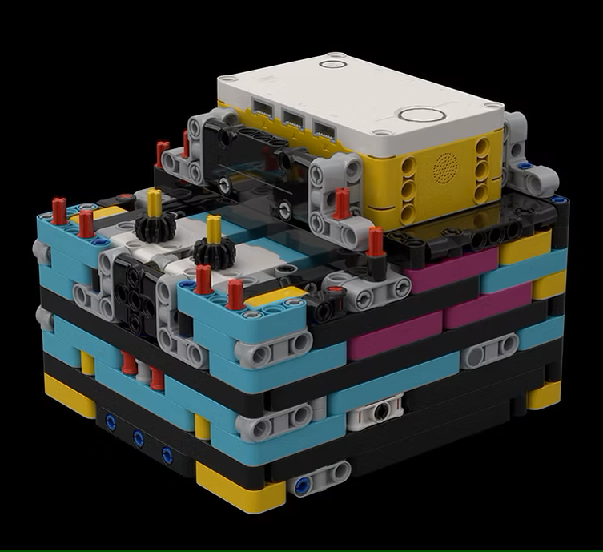
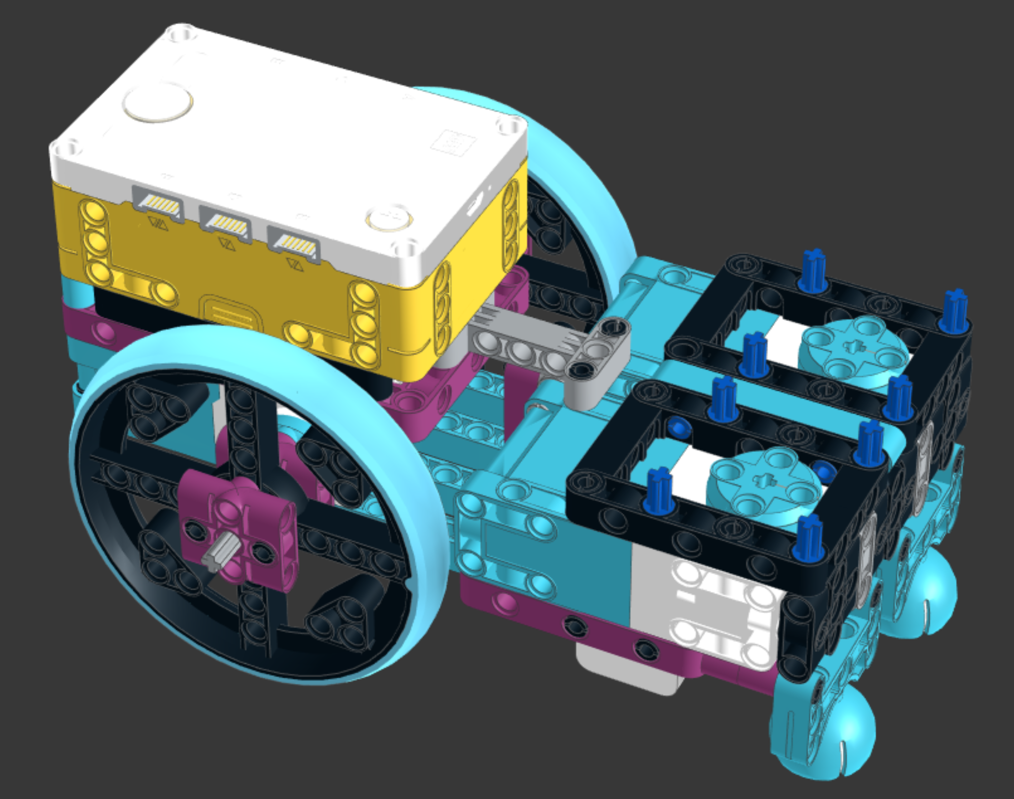
More Robot Bases
Base Robot Mark 2
Designed by Lucas and Dad (coach)
Projekt Alpha
www.nxtgen-robotics.com

Slide 30
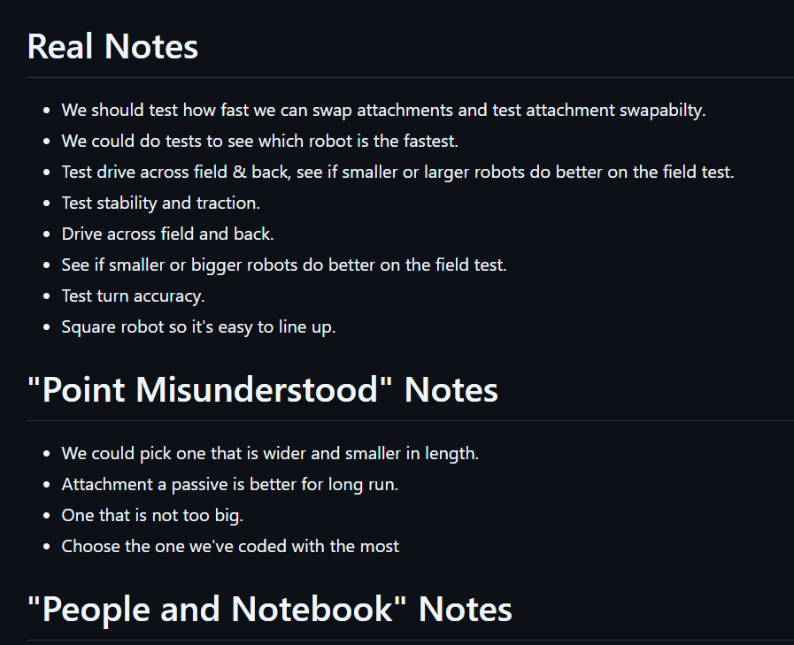
Brainstorming for robot base testing

Slide 31
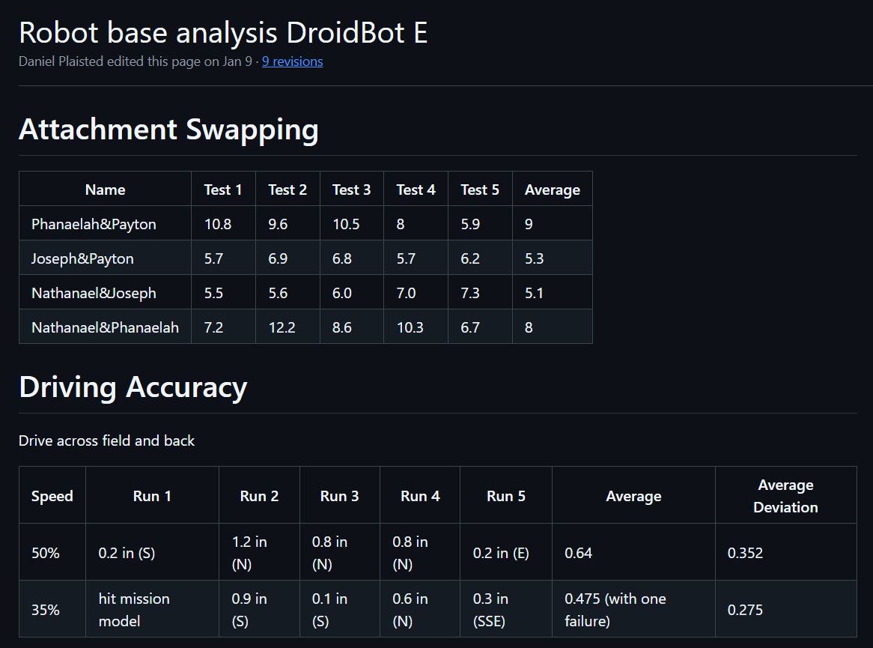
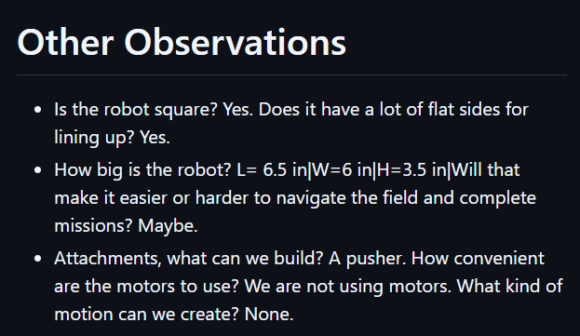
Robot base testing

Slide 32
Testing results
DroidBot M
Hard to swap for some, attachment can come apart
Very precise, good accuracy
DroidBot E
Nice attachment system (some disagreement)
Driving accuracy pretty good
Base Robot Mark 2
Very easy to swap attachments
Not so good driving accuracy
Coop Bot
Hard to swap attachments, can be done with the right strategy
Driving accuracy pretty good
Box-like, sturdy structure
Projekt Alpha
Very easy to swap attachments
Very poor driving accuracy in testing - maybe we can fix

Slide 33
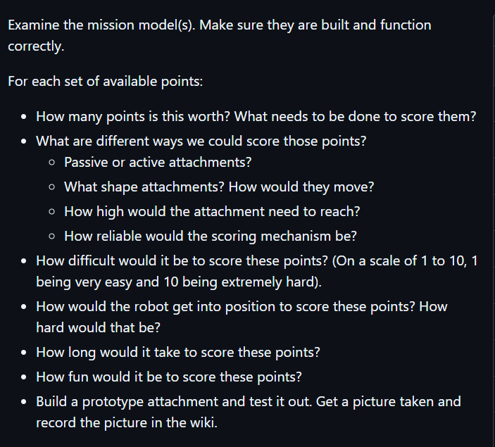
Mission analysis
Assignments:
1 – Coral Reef: Lucas and William
2 – Marcus: Alex, Leo, Nathaneal, Payton
3 – Coral Reef: Phanaleah, Natalia, Weston
4 – Scuba Diver: Joseph
5 – Angler Fish: Caleb, Paul, Rogelio
10 – Submersible: Diego, Lucas, William
12 – Feed the Whale: Caleb, Paul

Slide 34
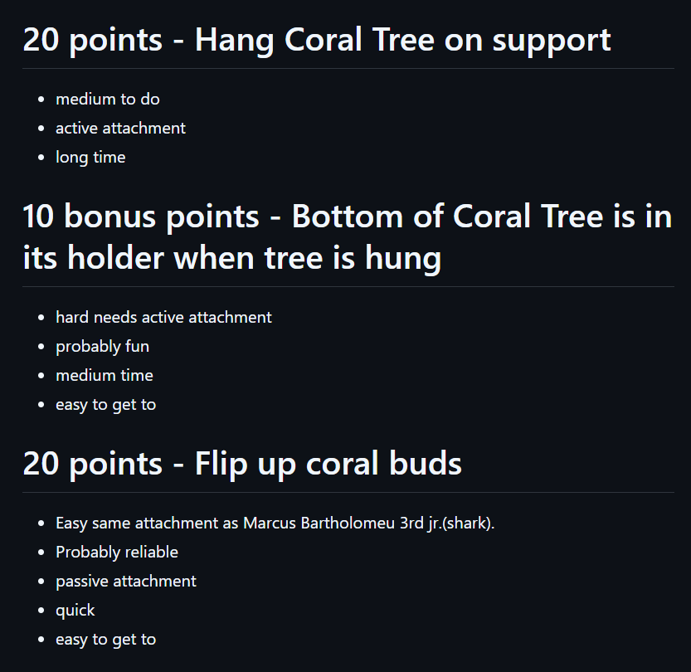
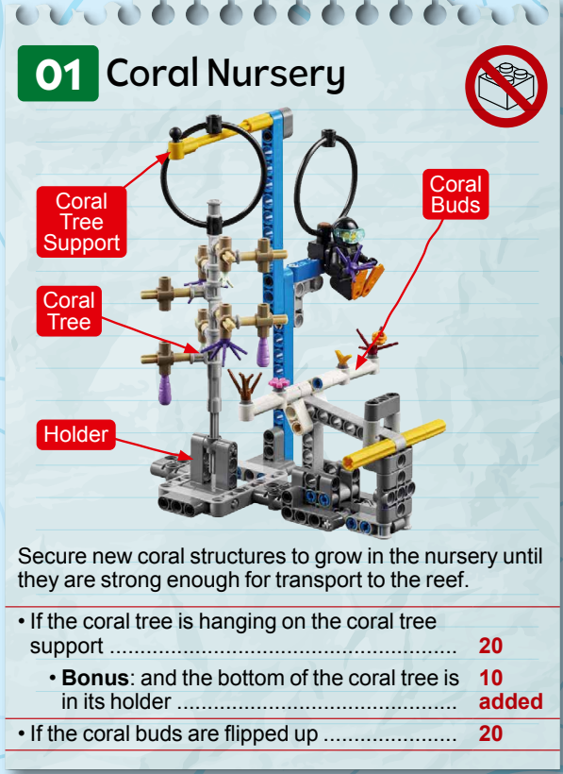
Mission Analysis

Slide 35
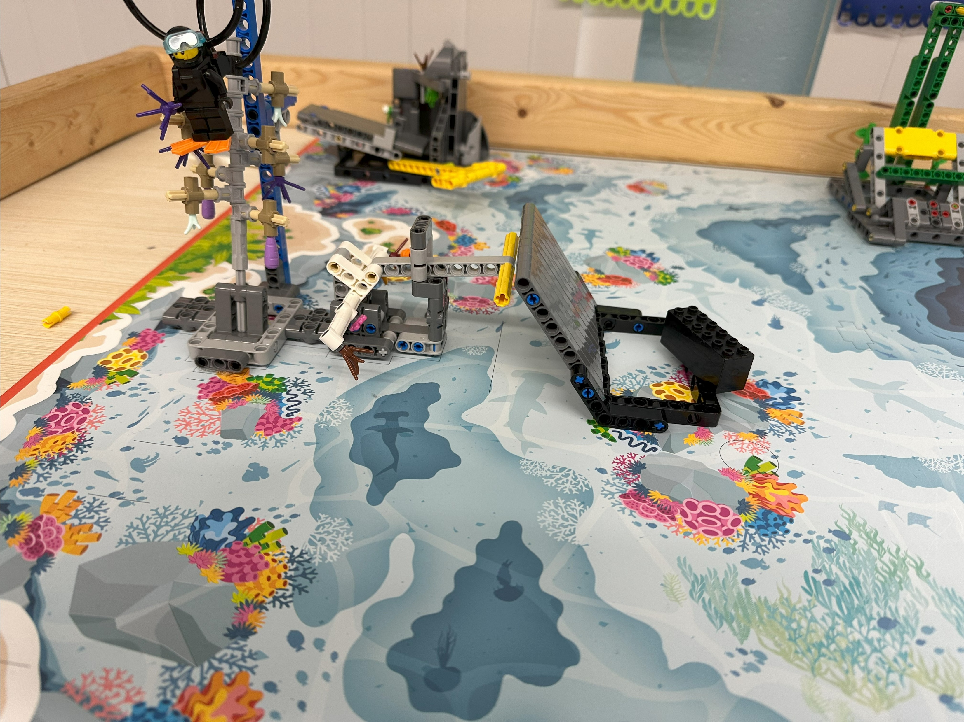
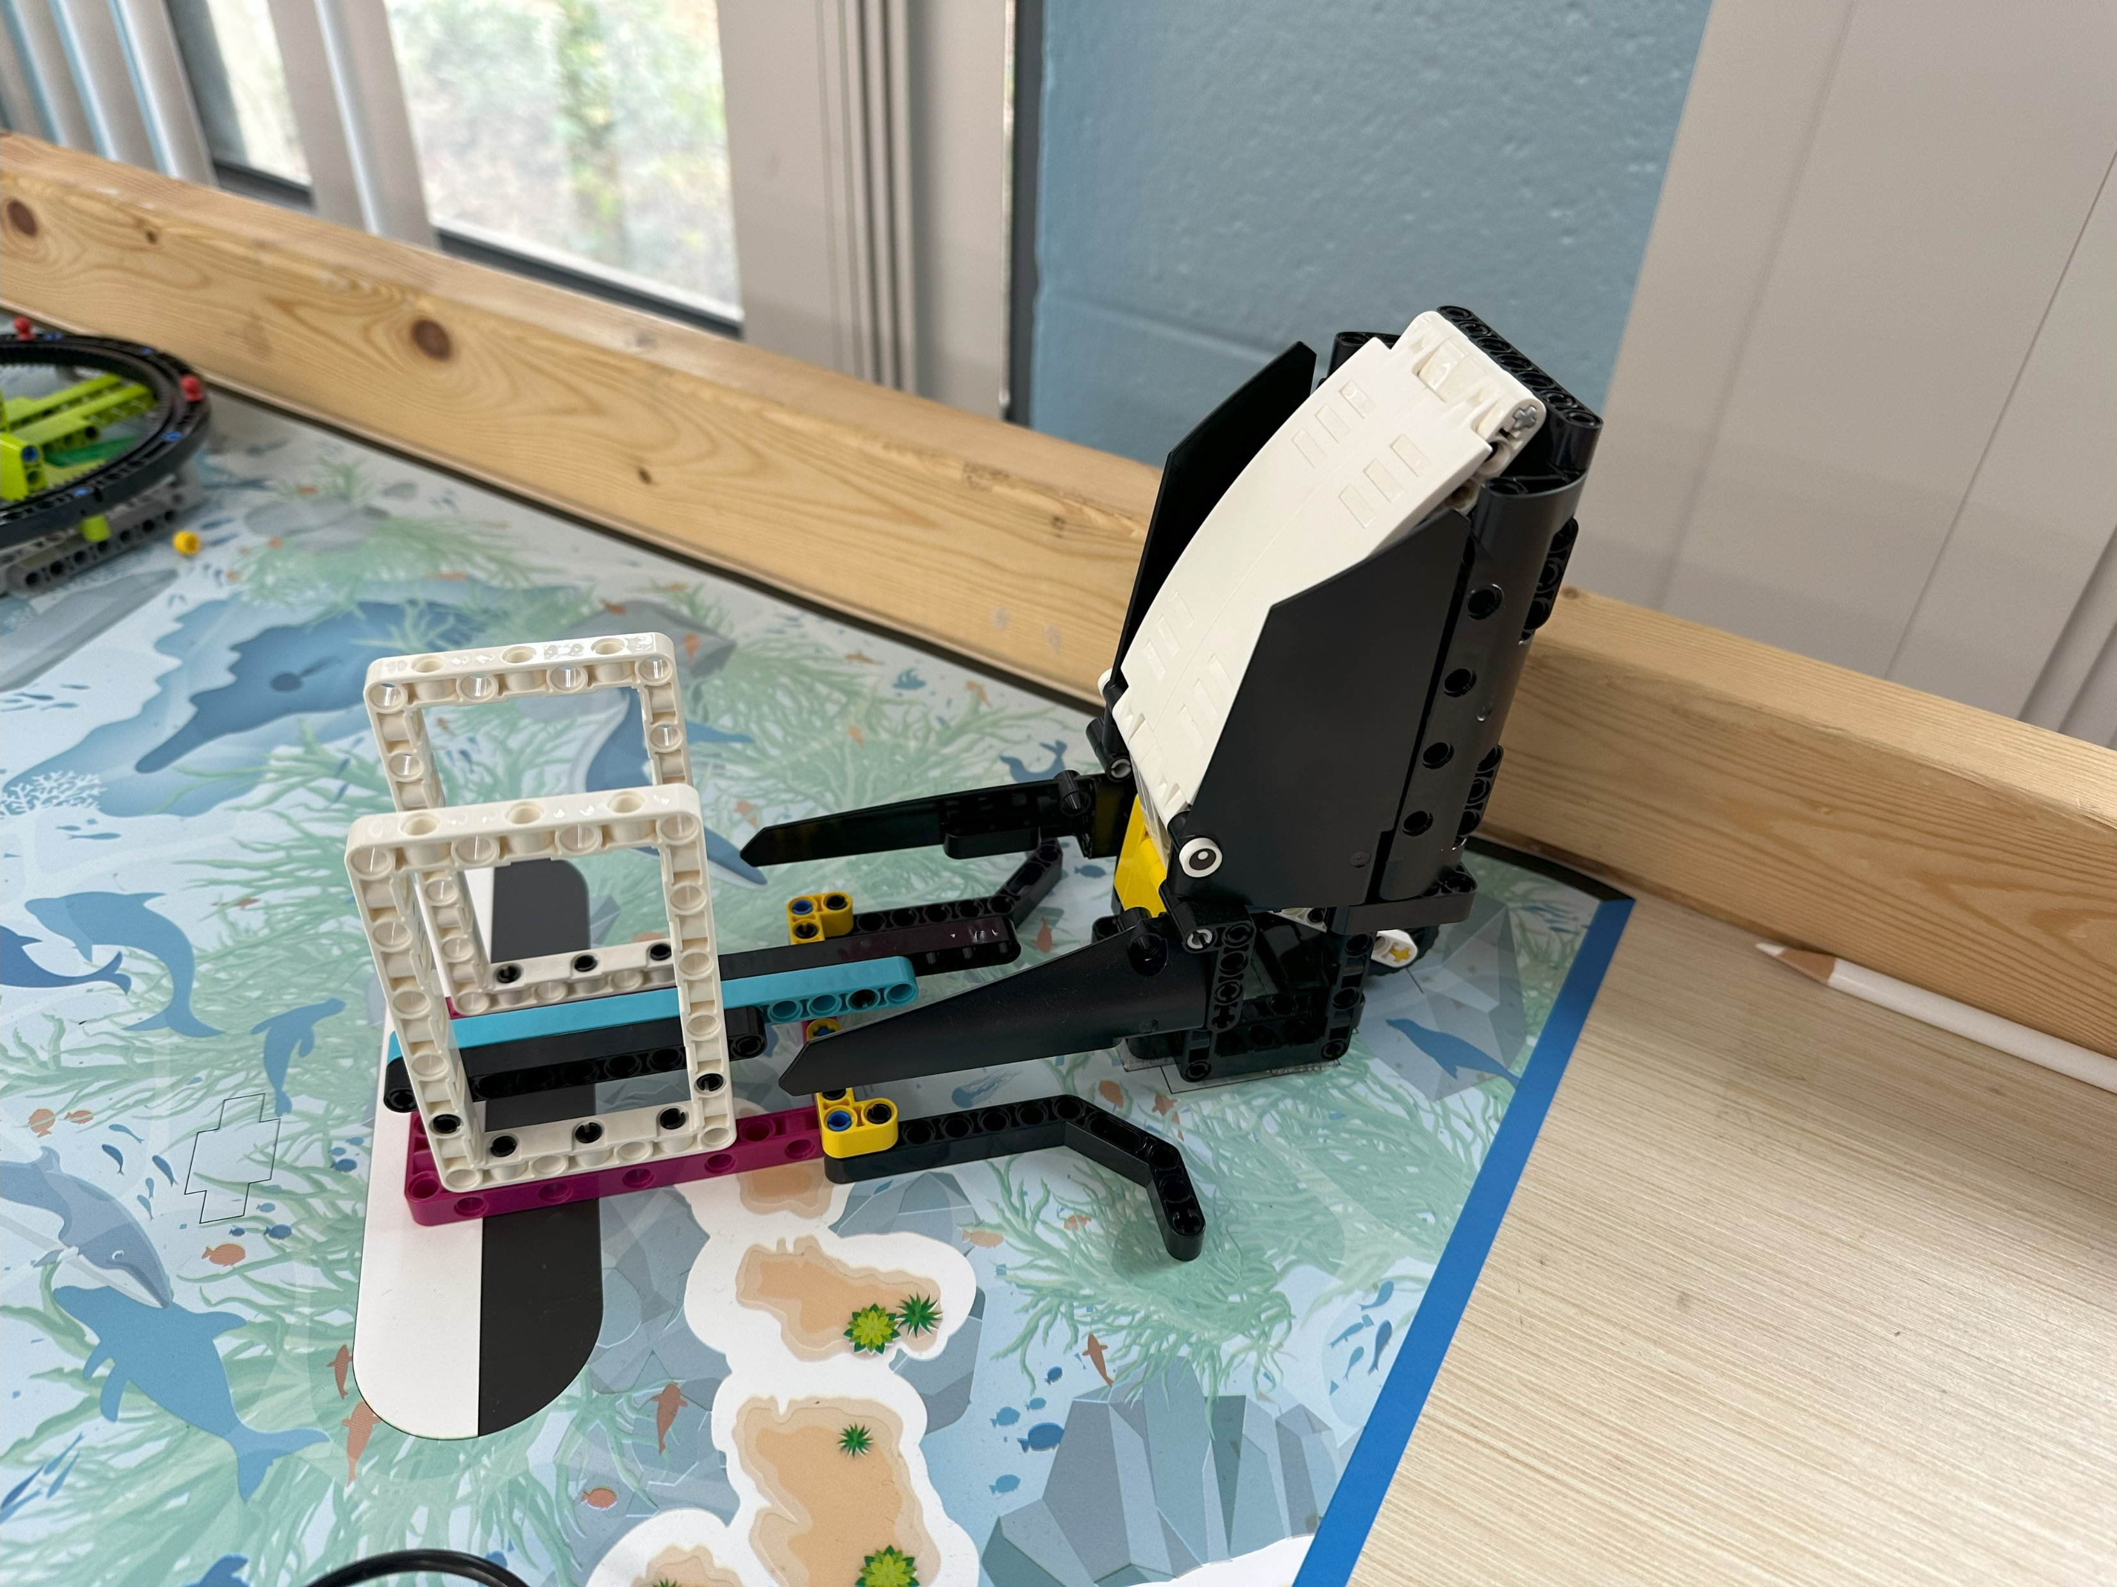
Attachment Prototyping

Slide 36
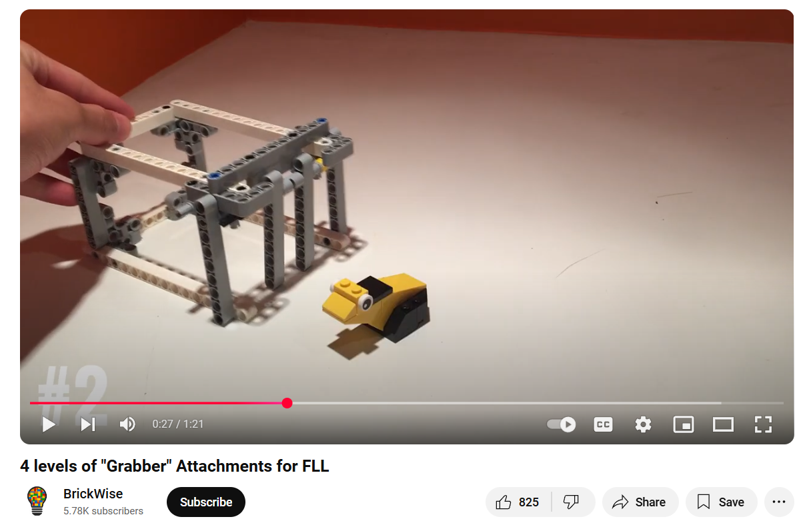
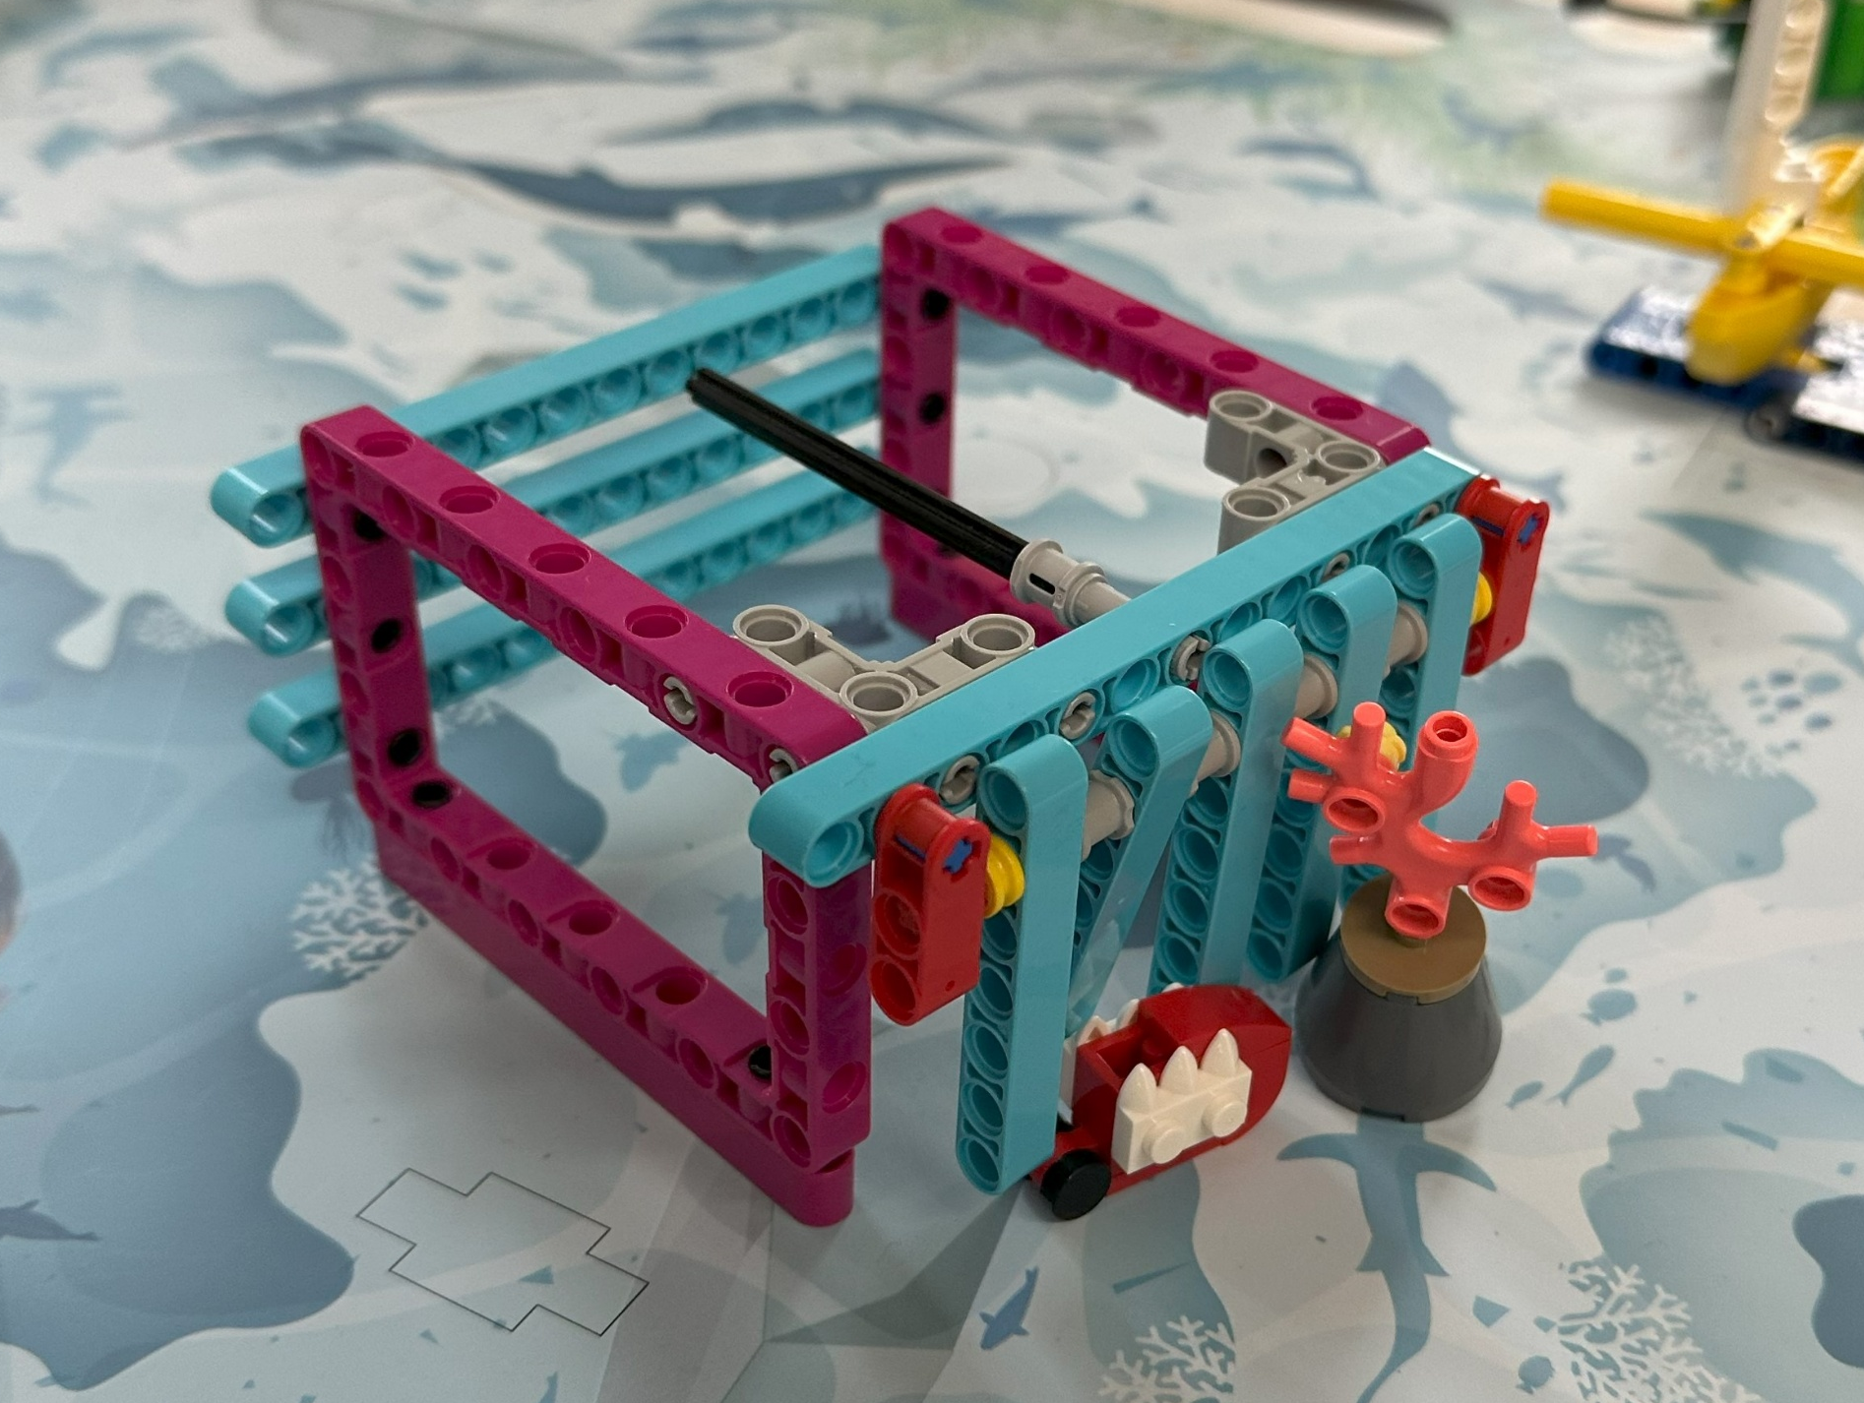
Attachment Prototyping – One Way Door
4 levels of “Grabber” Attachments Video
Our Prototype

Slide 37
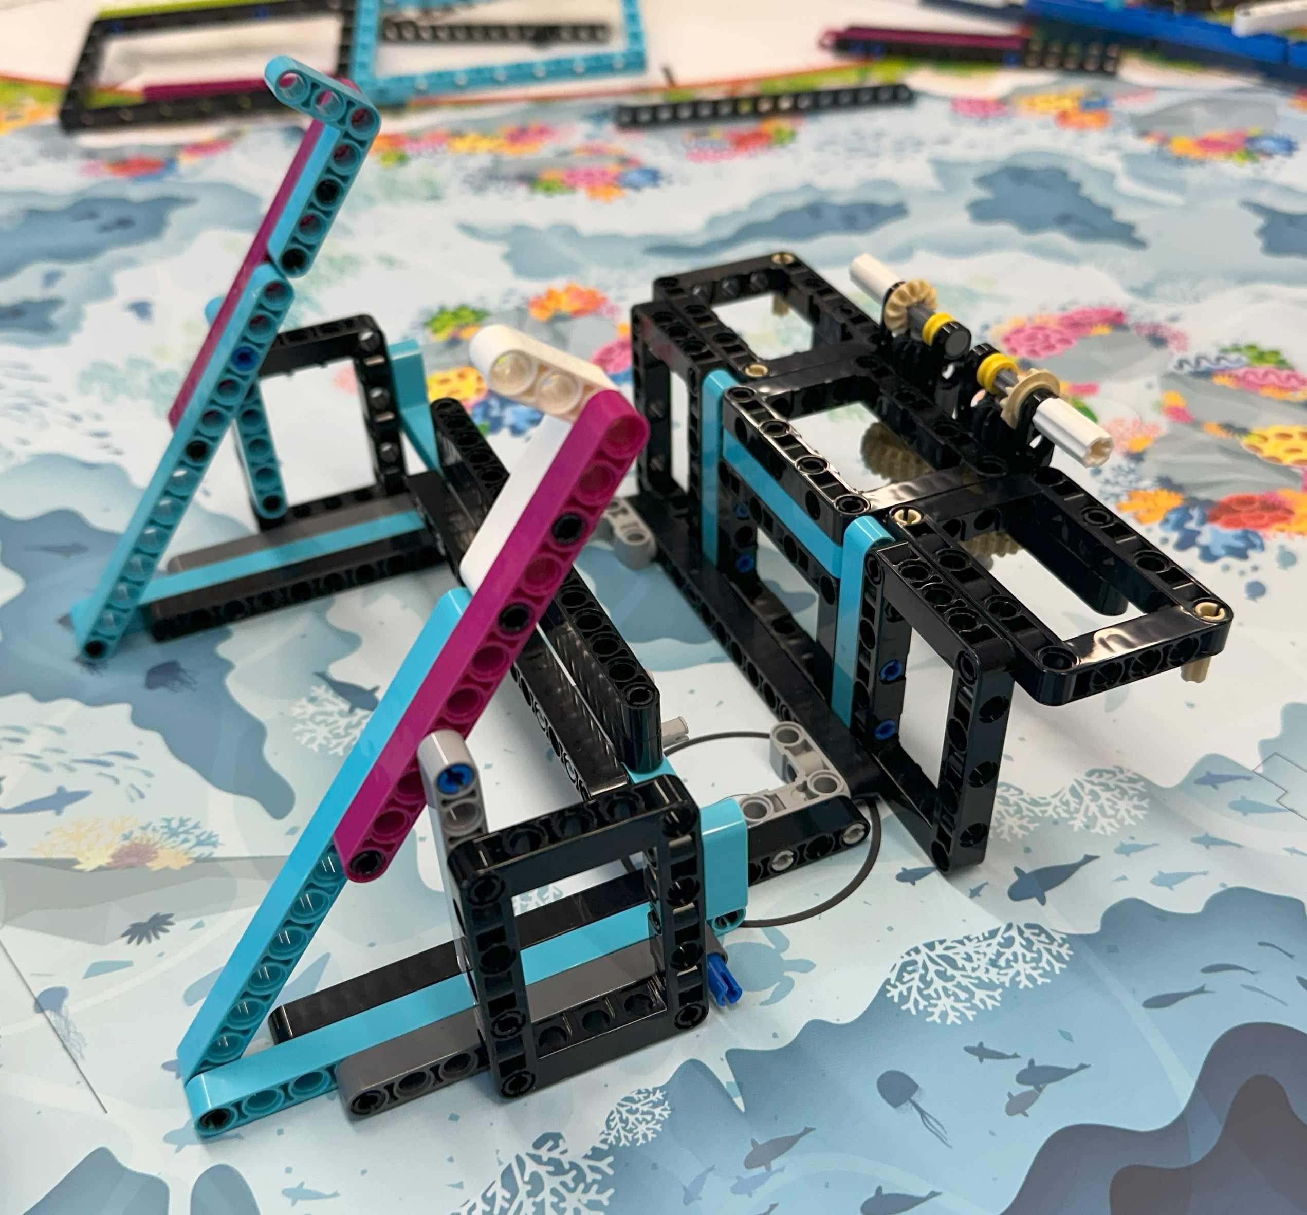
Attachment Development: Raise the Mast and Kraken’s Treasure

Slide 38
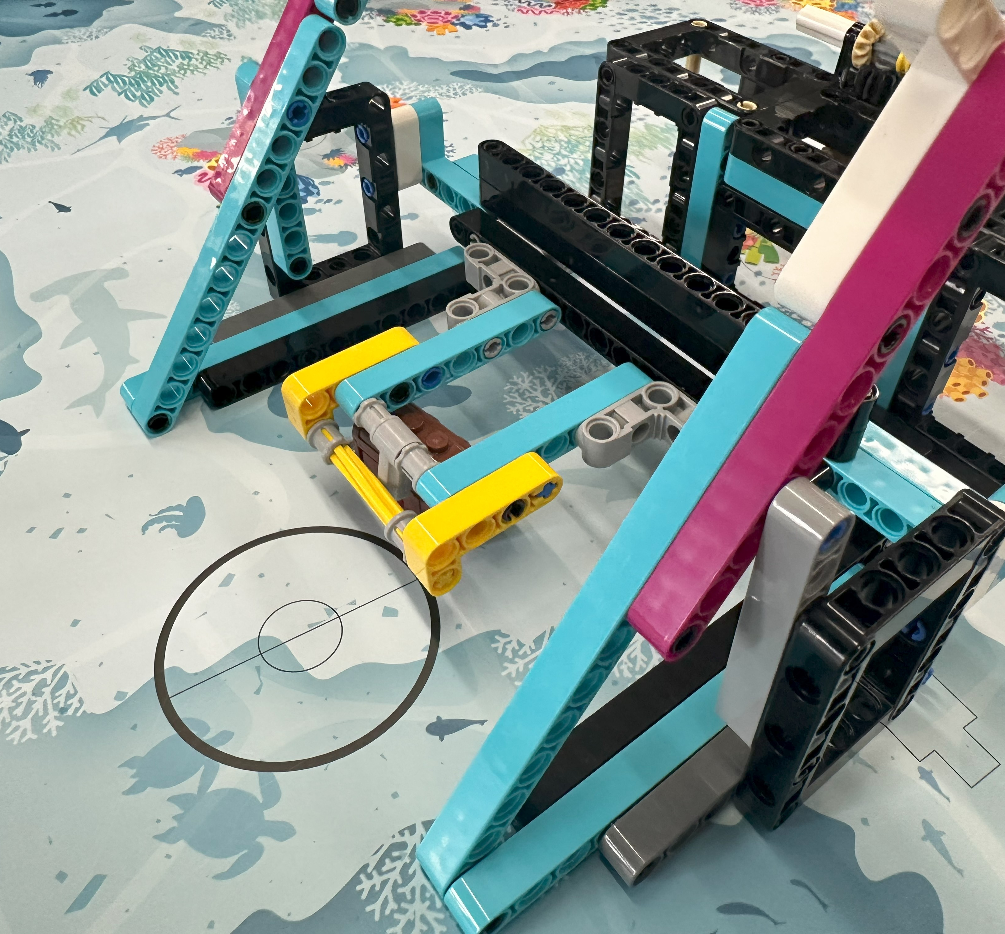
Attachment Development: Raise the Mast and Kraken’s Treasure

Slide 39
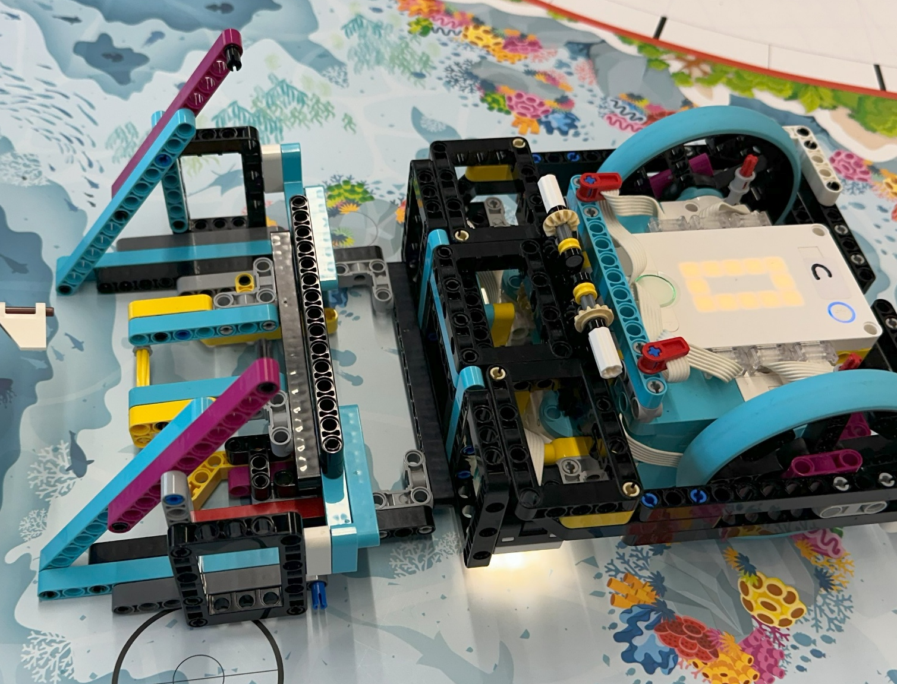
Attachment Development: Raise the Mast and Kraken’s Treasure

Slide 40
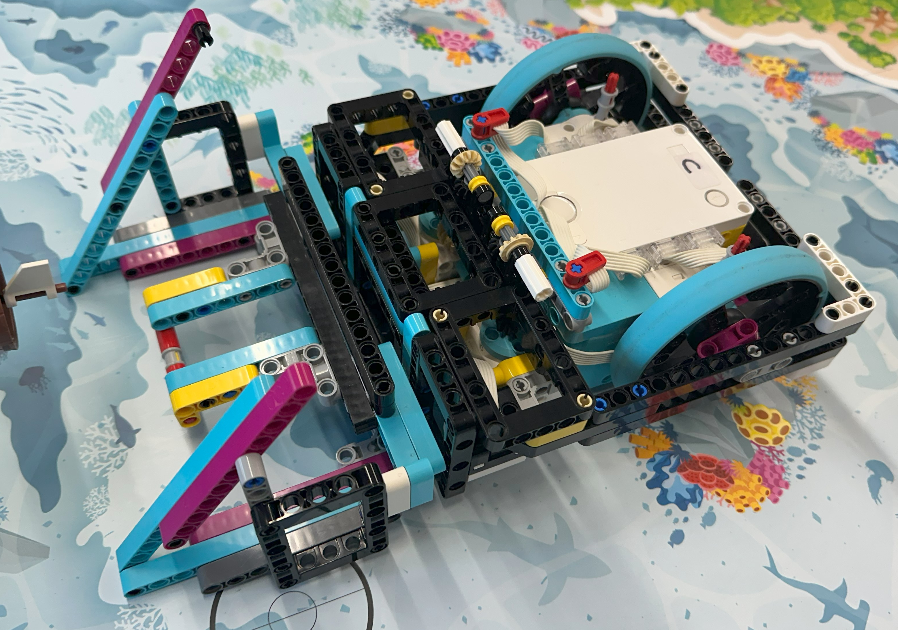
Attachment Development: Raise the Mast and Kraken’s Treasure

Slide 41
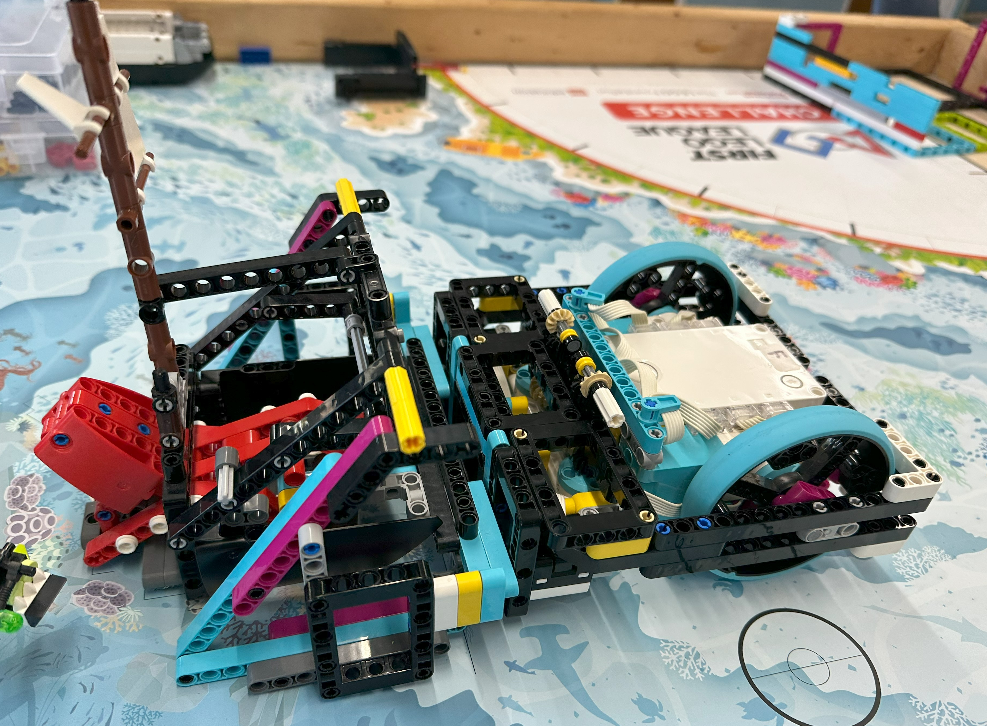
Attachment Development: Raise the Mast and Kraken’s Treasure

Slide 42
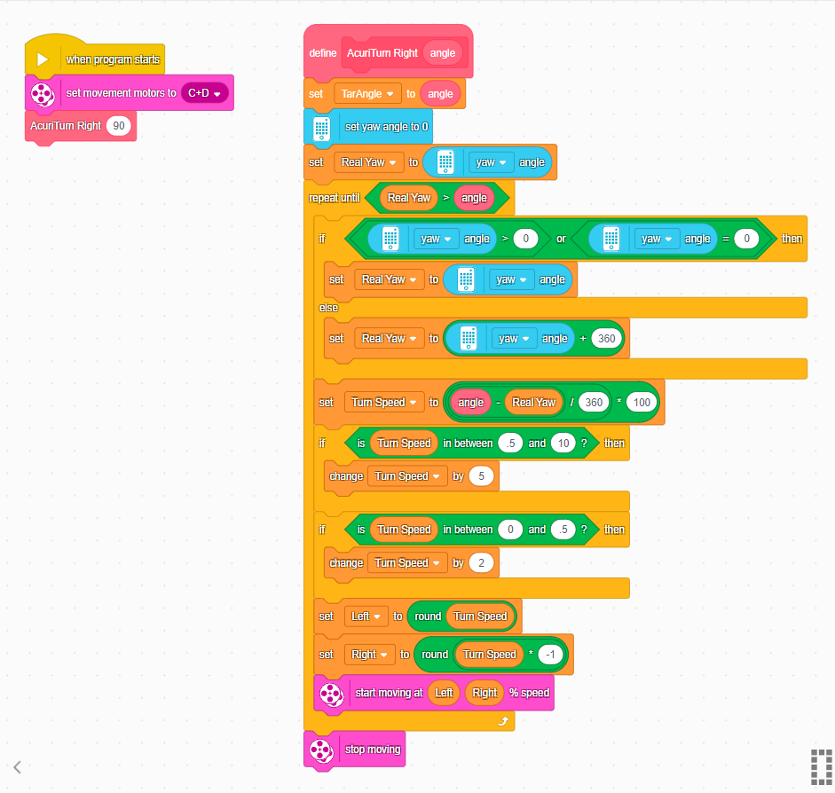
Programming – Gyro Turns in Spike Prime (Scratch)

Slide 43

Programming – Gyro Turns With Python and PyBricks

Slide 44
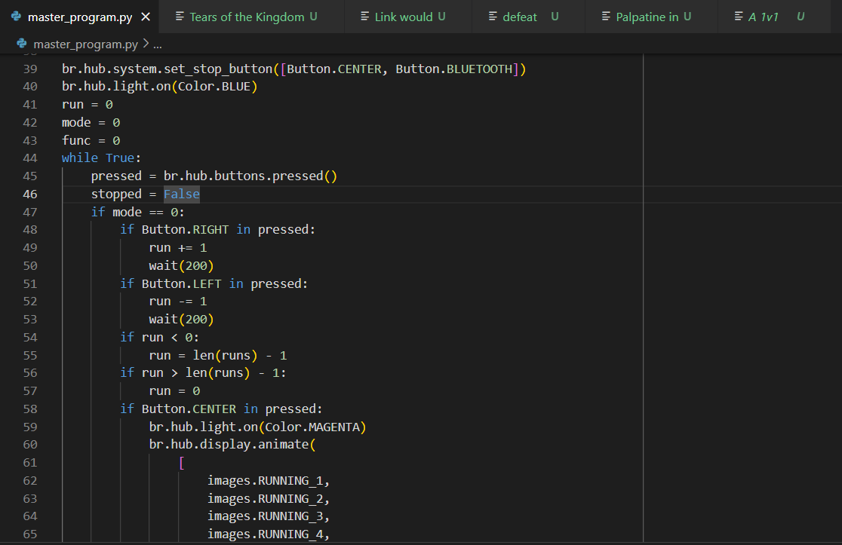
Advantages of Python
Uses gyro
PID controller
Easy file sharing/git source control
Can input degrees for turns
Easier to display images
Easier to play music

Slide 45
Coding Resources
PyBricks – www.pybricks.com
GitHub - github.com/wccarobotics/submerged
FLL Team 24277 - github.com/fll-Team-24277

Slide 46
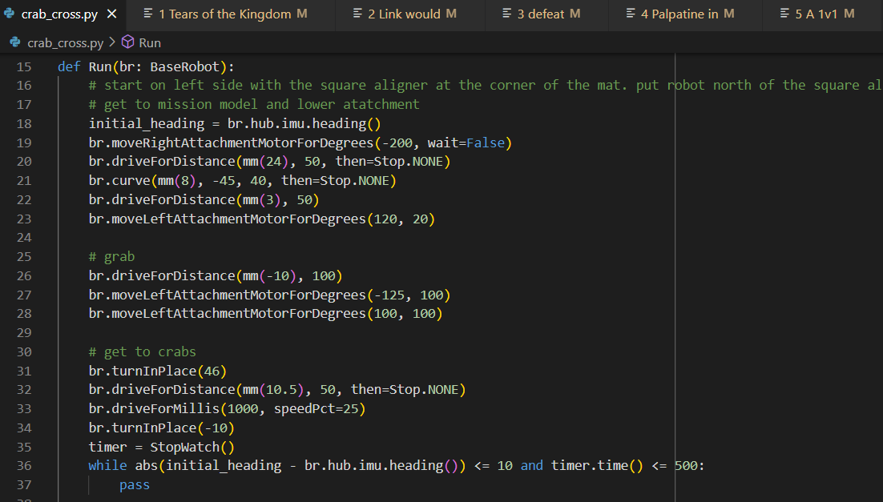
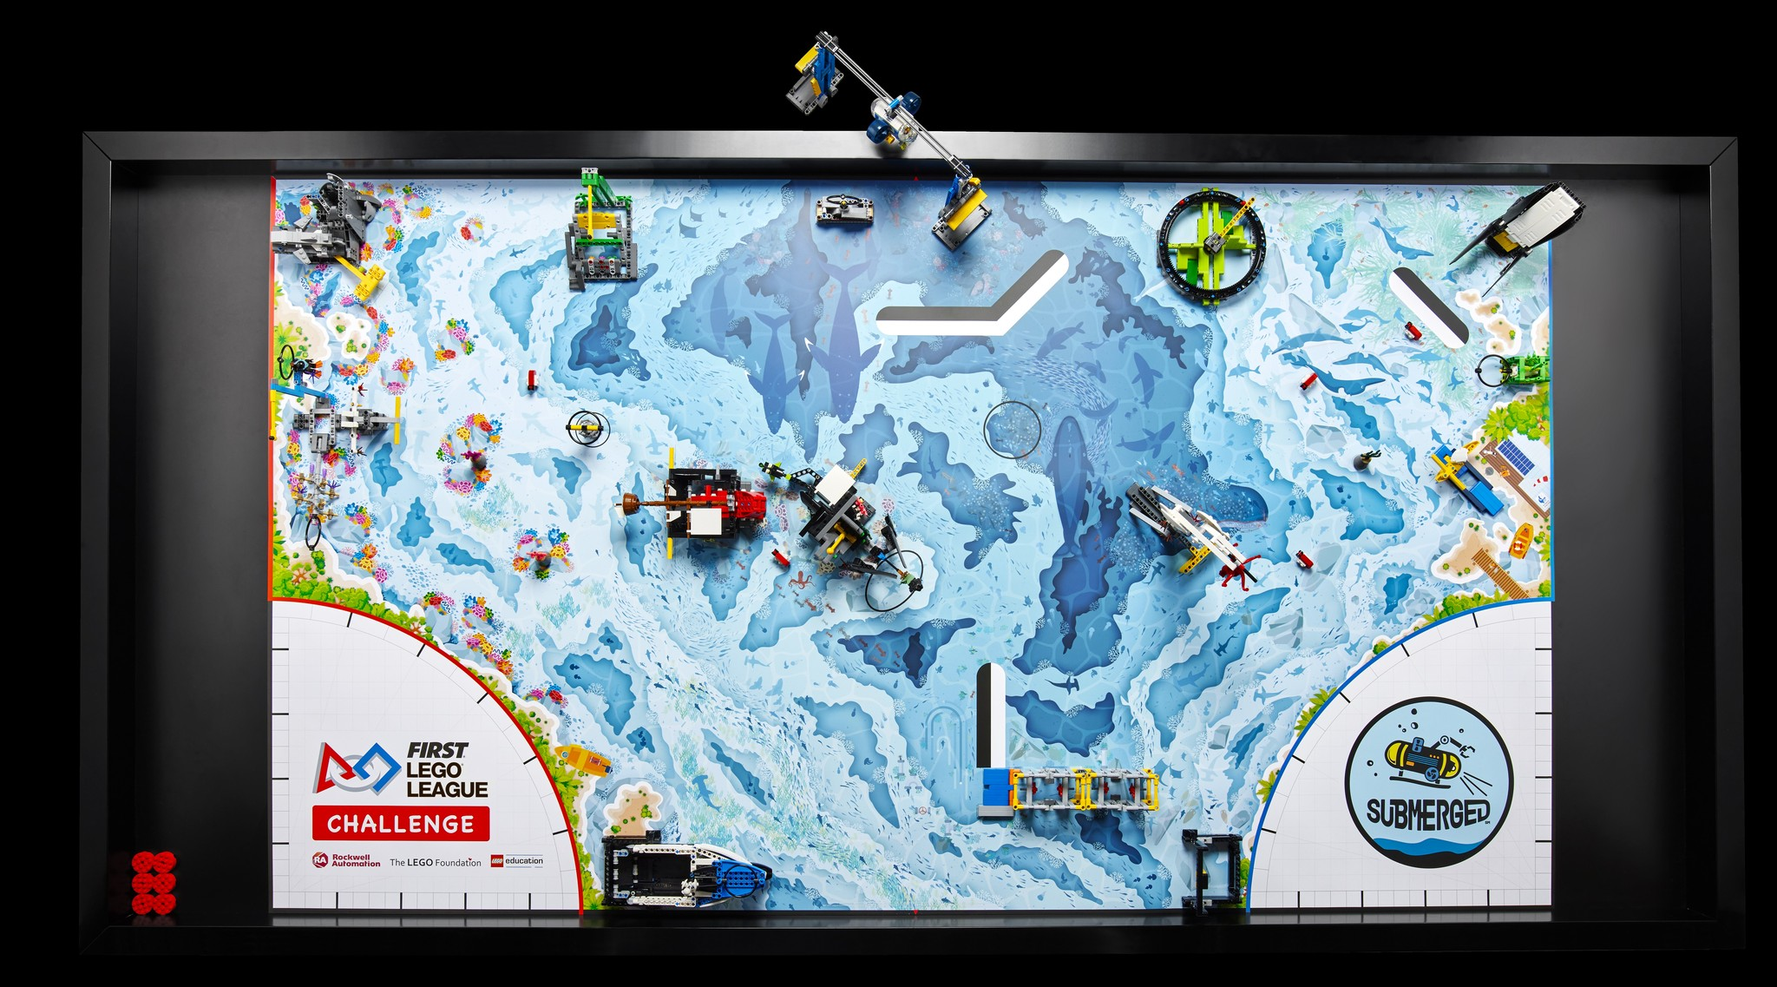
Mission code: Board Crossing+
2
3
1
4
5

Slide 47
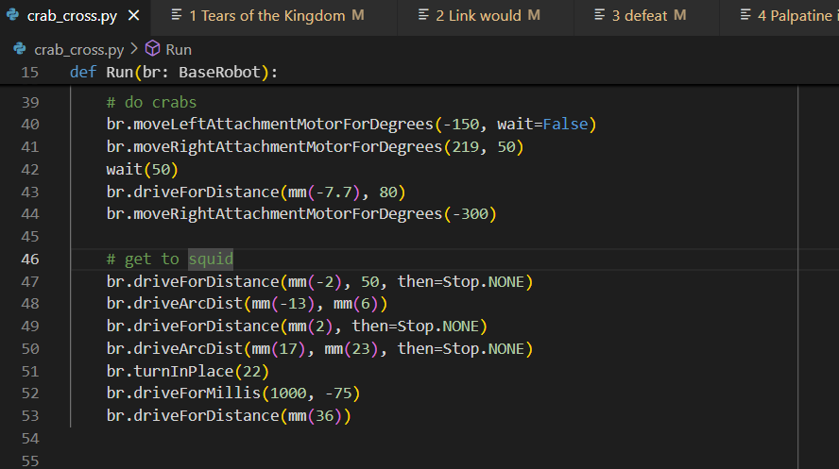
Mission code: Board Crossing+
9
10
7
8
6

Slide 48
Mission Strategy
Avoid crossing board more than once.
Complete multiple missions that are close to each other with the same attachment.
Use passive attachments when possible, use motorized attachments when necessary

Slide 49
Original Mission Strategy
Run 1
start on left side
Move water sample and reef segments to the edge of the board (reef segments must be up).
slanted attachment to do Marcus(shark) and flip coral buds up.
maybe remove diver and flip coral buds.
end on left side
Run 2
start on left side
carry Marcus over
slanted attachment to raise mast and maybe remove chest
maybe remove seabed sample from stand
bump into the submersible mission to lower yellow flag and maybe use a long rod to push it over.
end on right side
Run 3
start on right side
bump into squid (Squidward)
end on right side
Run 4
start on right side
carry Marcus and Squidward
drop off Marcus at his area
do anglerfish
drop Squidward off at his area.
Run 5
start on right side
remove kelp sample from stand
do sonar mission.

Slide 50
Original Mission Strategy
8
5
6
7
4
7
6
3
4
1
5
2
5
6
3
4
4
5
3
2
3
1
2
2
1
6
1
2
1

Slide 51
Qualifier Mission Strategy
Run 0
start on left side
knock debris out of way
flip coral reef
Return to left side
Run 1
Slanted attachment to release Marcus Bartholomew The Third Jr. (shark) and flip coral buds up.
Remove and deliver diver.
Run 2
slanted attachment to raise mast and remove chest
Run 3
start on left side
deliver Marcus
Remove trident top, maybe bottom
end on right side
Run 4
bump into squid (Squidward)
Run 5
do boat mission
do sonar mission
remove kelp sample from stand
Run 6
Bump into submersible to lower flag
spear submersible over
Tactical robot grab with free precision token
Run 7
carry Squidward
do anglerfish
drop Squidward off at his area.
Don’t return home

Slide 52
Qualifier Mission Strategy
= Run 0
1
3
7
2
6
= Run 1
4
4
5
5
= Run 2
6
2
6
1
7
3
2
= Run 3
6
4
3
3
5
4
5
2
= Run 4
3
2
4
2
1
5
2
= Run 5
1
1
3
1
1
2
= Run 6
1
= Run 7
4

Slide 53
Current Mission Strategy
Run 0
start on left side
knock debris out of way
flip coral reef
Return to left side
Run 1
Slanted attachment to release Marcus Bartholomew The Third Jr. (shark) and flip coral buds up.
Remove and deliver diver.
Run 2
slanted attachment to raise mast and remove chest
Run 3
start on left side
deliver Marcus
remove trident top, maybe bottom
do crabs
Release Squidward
end on right side
Run 4
do boat mission
do sonar mission
remove kelp sample from stand
Run 5
carry Squidward
do anglerfish
grab seabed sample
Send over submersible
drop Squidward off at his area.
don’t return home
Play celebration!

Slide 54
Current Mission Strategy
= Run 0
5
6
7
1
3
4
= Run 1
2
6
4
4
5
5
= Run 2
6
2
6
1
3
= Run 3
3
2
= Run 4
3
2
4
2
9
5
= Run 5
2
3
1
1
1
7
10
8
4
1
6
5

Slide 55
Who worked on building and coding
Run 1: Clear field, coral reef – Lucas
Run 2: Reef, Shark, Diver
Building: Nathaneal
Coding: Nathaneal, Lucas, Caleb
Run 3: Raise the Mast / Kraken
Building: Phanaleah, Payton, Weston
Coding: Nathaneal, Joeseph, Weston
Run 4: Cross field, trident, deliver Marcus –
Building: Lucas
Coding: Lucas, Leo
Run 5: Unknown creature / squid
Natalia, Hely, Lesly, Payton, Lucas
Run 6: Shipping lanes and sonar – Lucas
Run 7: Send over submersible
Building - Lucas
Coding – Phanaleah, Lucas
Run 8: Angler fish, deliver squid
Building – Caleb, Lucas
Coding: Caleb, Lucas
Research vessel (abandoned)
Building: Paul, Leo, Nathaneal

Slide 56
Lessons learned / advice for other teams
Easy points you can score today!
20 points – Unknown creature
Drive forward and then back
No attachment needed, flat front of robot helps
Drive forward for time, not distance to avoid getting stuck
30 points – Send over the submersible
Just bang into the vertical support to knock the flag down
This will work better if you make contact higher on the support
40 points – Coral buds and shark
Create a wall slanting up and away at the front of the robot
Drive into the coral nursery and shark mission models to activate them
Suggestions for next year
Try passive attachments, especially for things like levers that need to be pushed down or up
Test different robot bases
Check out FLLTutorials.com for some great designs to try
Use a robot with a flat back and line it up against the wall for launch
Consider using aligners for quicker and more accurate launch positioning
Consider using Python and PyBricks
For guidance and examples, see https://github.com/FLL-Team-24277/FLL-Fall-2024-Submerged
Respect Marcus Bartholomew the Third Junior! OR ELSE…*
*For legal reasons this is NOT a threat. We are not responsible for shark related threats. If you feel threatened by a shark, call the national shark threat hotline at 321-867-5309.

Slide 57



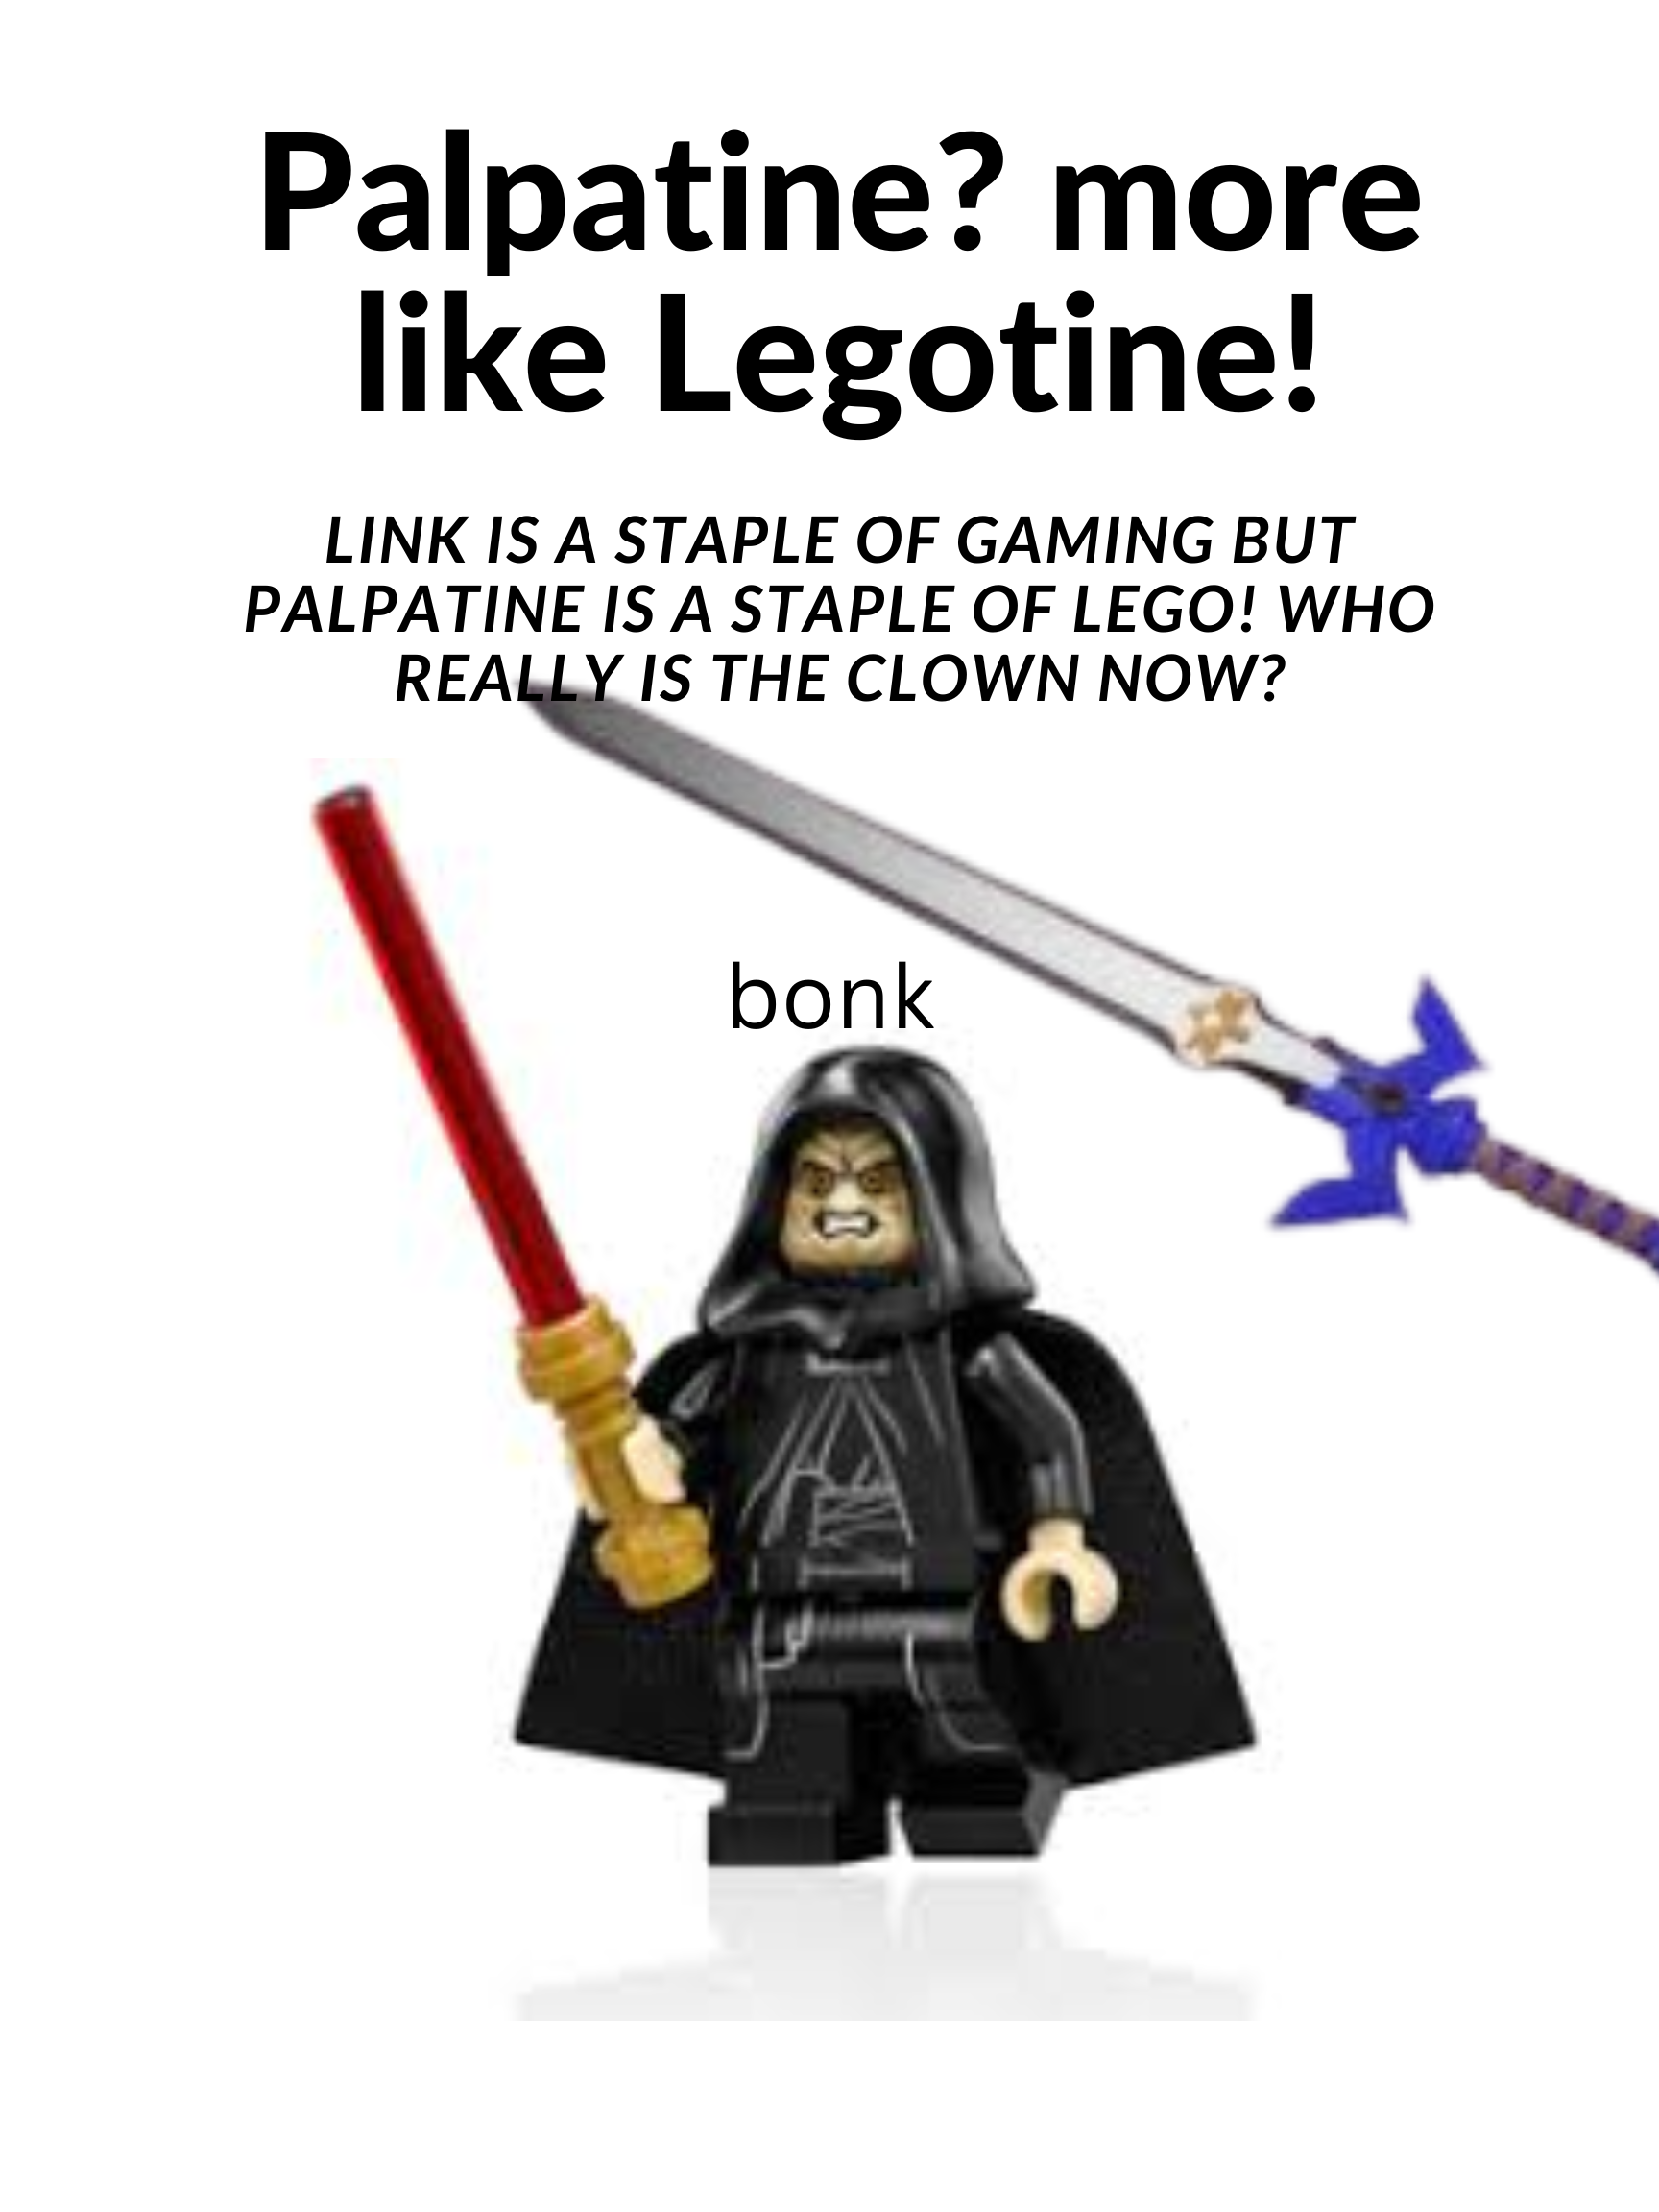

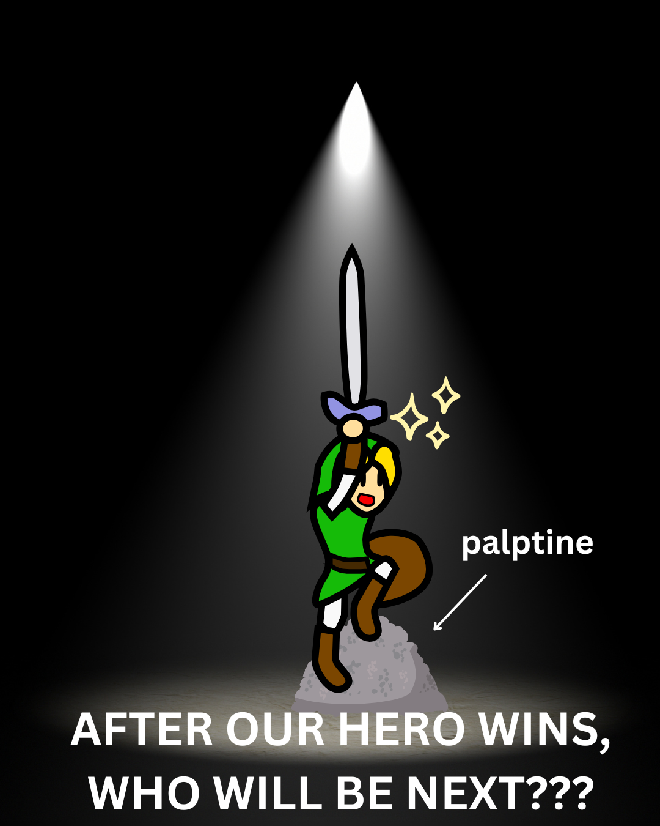
Messages From Our Sponsors

Slide 58
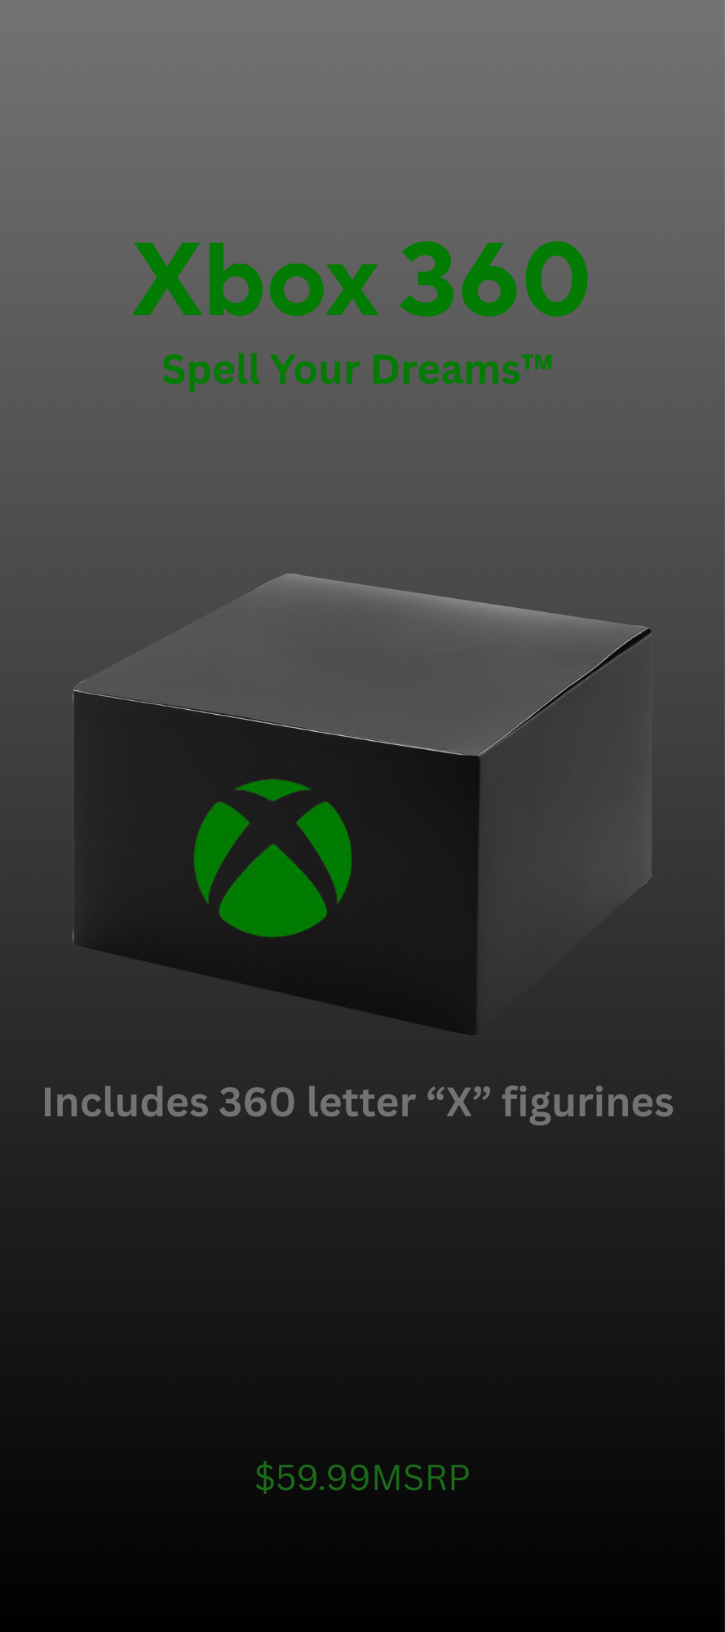



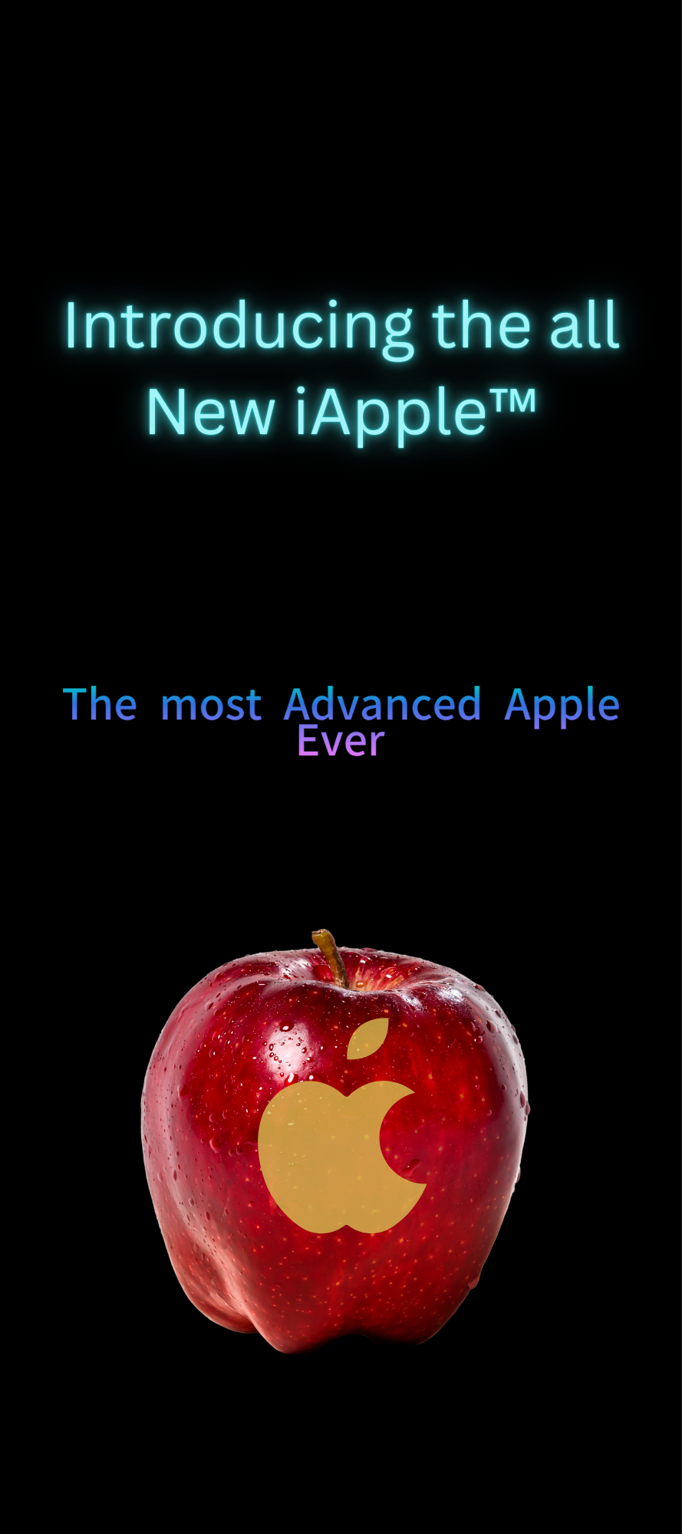
Messages From Our Sponsors

Slide 59
The End! And Link would win!

